Slide 1

Addis Ababa Science and Technology University Collage of natural and social science Department of Statistics and Physics
Probability and statistics
By Mulugeta G. (BSc, MPH)
Email: mullergaro@gmail.com
2022

Slide 2
Introduction to Statistics
Objectives:
At the end of this session, students should be able to:
understand statistics and basic terminologies
understand scales of measurement in statistics
understand the basic methods of data collection

Slide 3
Definition of Statistics
The word statistics has several meanings.
We can define statistics either in plural or singular sense.
In plural sense: statistics is defined as the collection of numerical facts or figures (or the raw data themselves).
In this sense the word 'statistics' is usually understood by a layman.

Slide 4
Eg. 1. Vital statistics (numerical data on marriage, births, deaths, etc).
2. The average mark of statistics course for students is 70% would be considered as a statistics whereas Abebe has got 90% in statistics course is not statistics.
Remark: statistics are aggregate of facts. Single and isolated figures are not statistics as they cannot be compared and are unrelated.

Slide 5
Definition of Statistics
In its singular sense:- Statistics is the science that deals with the methods of collecting, organizing, presenting, analyzing and interpreting statistical data.

Slide 6
Classification of Statistics
Statistics may be divided into two main branches:
Descriptive Statistics
Inferential Statistics

Slide 7
Classification of Statistics cont…
Descriptive statistics:
Includes statistical methods involving the collection, presentation, and characterization of a set of data in order to describe the various features of the data.
Methods of descriptive statistics include graphic methods (bar chart, pie chart, e t c) and numeric measures (mean, median, variance e t c).
Descriptive statistics do not allow us to make conclusions beyond the data we have analyzed.

Slide 8
Classification of Statistics cont…
Meaningful and pertinent information cannot be realized from raw data unless summarized by the tools of descriptive statistics.
Descriptive statistics, therefore, allow us to present the data in a more meaningful way which allows interpretation of the data easily.

Slide 9
Classification of Statistics cont…
Inferential statistics:
Includes statistical methods which facilitate estimation the characteristics of a population or making decisions concerning a population on the basis of sample results.
In this regard, methods like estimation and hypothesis testing are examples of inferential statistics.

Slide 10
Classification of Statistics cont…
For example, a biologist collected blood samples of 10 students from biology department to study blood types. Accordingly, the following data is obtained:
O A O AB A A O O B O
Summary measures, for example, the proportion of students with blood type O in the sample is 50% is an example of descriptive statistics. We can also describe the data using bar or pie charts.
However, if he/she wants to get information on the proportion of students with blood type O in the entire class, he/she may use the sample proportion (50%) as an estimate of the corresponding value of the entire class. This is an example of inferential statistics.

Slide 11
Stages in statistical investigation
A statistical study might involve the following stages: collection of data, organizing and presenting the collected data, analyzing and interpreting the result.
Stage 1: Data collection: this stage involves acquiring data related with the problem at hand.
Stage 2: Organizing: this stage involves the classification or sorting the collected data based on some characteristics or attributes such as age, sex, marital status e t c.
Stage 3: presenting data: Further we may use tables, graphs, charts so on to present the data.

Slide 12
Stages in statistical investigation
Stage 4: Data analysis: analysis of the data is necessary in order to reach conclusions or provide answers to a problem. The analysis might require simple or sophisticated statistical tools depending on the type of answers that may have to be provided.
Stage 5: Interpretation of the result: logically a statistical analysis has to be followed by conclusions in order to be able to make a decision. The technical terminology used to describe this last process of a statistical study is referred to as interpretation.

Slide 13
Definition of some terms
A population: Consists of all elements, individuals, items or objects whose characteristics are being studied. The population that is being studied is called target population.
Sample: A portion of the population selected for study.
Sample survey: The technique of collecting information from a portion of the population.
Census survey: A survey that includes every member of the population.
Variable: is a characteristic under study that assumes different values for different element.
Quantitative variable: A variable that can be measured numerically. The data collected on quantitative variable are called quantitative data. Examples include weight, height, number of students in a class, number of car accidents, e t c.

Slide 14
Definition of some terms cont…
Qualitative variable: A variable that cannot assume a numerical value but can be classified into two or more non numerical categories. The data collected on such a variable are called qualitative or categorical data. Examples include sex, blood type, marital status, religion e t c.
Discrete variable: a variable whose values are countable. Examples include number patients in a hospital, number of white blood cells in a droplet of blood sample, number of rodents per plot of farmland e t c.
Continuous variable: a variable that can assume any numerical value over a certain interval or intervals. Examples include weight of new born babies, height of seedlings, temperature measurements e t c.

Slide 15
Definition of some terms cont.….
Parameter: A statistical measure obtained from a population data. Examples include population mean, proportion, variance and so on.
Statistic: A statistical measure obtained from a sample data. Examples include sample mean, proportion, variance and so on.
Unit of analysis: The type of thing being measured in the data, such as persons, families, households, states, nations, etc.

Slide 16
Limitation of statistics
Statistics deals with only those subjects of inquiry which are capable of being quantitatively measured and numerically expressed.
Statistics deals only with aggregates of facts and no importance is attached to individual items
Statistical data is only approximately and not mathematically correct
Statistics is liable to be misused. Hence expertise in the subject is very essential. Besides, honesty is very important in the use of statistics.

Slide 17
Scales of measurement
Formally, we distinguish among four levels of measurement scales.

Slide 18
Scales of measurements cont…
Nominal scale:
It is the simplest measurement scale.
There is no natural ordering of the levels or values of the scale in nominal scale.
For example, sex of an individual may be male or female. There is no natural ordering of the two sexes. Others examples include religion, blood type, eye colour, marital status e t c.
The values of nominal scale can be coded using numerical values;
However, we cannot perform any mathematical operations on the numbers used to code.

Slide 19
Scales of measurements cont..
Ordinal scale:
This measurement scale is similar to the nominal scale but the levels or categories can be ranked or order.
That is, we can compare levels or categories of the scale.
Therefore, this scale of measurement gives better information on the quantities being measured as compared to nominal scale. For example, living standard of a family can be poor, medium or higher.
These categories can be ordered as poor is less than medium and medium is less than higher class.
However, the distance or magnitude between the levels, say between poor and medium, is not clearly known.

Slide 20
Scales of measurements cont…
Interval scale:
This measurement scale shares the ordering or ranking and labeling properties of ordinal scale of measurement. Besides, the distance or magnitude between two values is clearly known (meaningful).
However, it lacks a true zero point (i.e., zero point is not meaningful). For example, temperature in degree centigrade or Fahrenheit of an object. If the temperature of an object is zero degree centigrade, it doesn’t mean that the object lacks heat. Hence zero is arbitrary point in the scale. It doesn’t make sense to say that 80° F is twice as hot as 40° F.
We can do subtraction and addition on interval level data but division and multiplication are impossible.

Slide 21
Scales of measurements cont…
Ratio scale:
It is the highest level of measurement scale.
It shares the ordering, labeling and meaningful distance properties of interval scale.
In addition, it has a true or meaningful zero point. The existence of a true zero makes the ratio of two measures meaningful. example includes, weight, height e t c.
We can do subtraction, addition, multiplication and division on ratio level data.

Slide 22
Scales of measurements cont…
The more precise variable is ratio variable and the least precise is the nominal variable. Ratio and interval level data are classified under quantitative variable and, nominal and ordinal level data are classified under qualitative variable.

Slide 23
Addis Ababa Science and Technology University Collage of natural and social science Department of Statistics and Physics
Probability and statistics
By
Mulugeta G. (BSc, MPH)
Email: mullergaro@gmail.com
2022

Slide 24


Slide 25
After completing this unit you should be able to:
organize data using frequency distribution.
present data using suitable graphs or diagrams.

Slide 26
Methods of data collection
Depending on the source, data can be classified in to two:
Primary data &
Secondary data
Primary data refers to the statistical data which the investigator originates for the purpose of inquiry.
Secondary data refers to data which is not originated by the investigator himself, but which he/she obtains from someone else records. Secondary data can be obtained from published or unpublished documents: reports, journals, magazines, articles e t c.

Slide 27
Methods of data collection cont…
Primary methods of data collection: It includes data collection using observation, personal interview, self administered questionnaire, mailed questionnaire etc.

Slide 28
Classification and tabulation of data
The uses of classifying and tabulating data are:
to display the points of similarity and dissimilarity;
to save mental strain by systematic condensation and suppression of irrelevant detail;
to enable one to form a mental picture of objects of perception; and
to prepare the ground for comparison and inference.

Slide 29
Types of classification
Geographical- in terms of cities, districts, countries etc.
Chronological - on the basis of time
Qualitative - according to some qualitative characteristics.
Quantitative – in terms of magnitude.

Slide 30
Tabulation
Tabulation: tables may be classified according to the number of characteristics used for tabulation.
Simple or one way table: it uses only one characteristic or variable for classification.
Example 2.1: Students who took introduction to statistics in 2014 G.C.by gender.
Gender | Number
Male | 2000
Female | 700

Slide 31
Tabulation cont…
Two-way tables: it uses two variables for classification.
Example 2.2: Students who took introduction to statistics in 2007 E.C.by age and gender.
Age | Gender
 | Number of male | Number of female
19 and below | 200 | 180
20-25 | 1415 | 385
26 and above | 385 | 135

Slide 32
Frequency distributions
Frequency distribution is the easiest method of organizing data, which converts raw data into a meaningful pattern for statistical analysis.

Slide 33
The main uses of a frequency distribution are:
to organize data in a meaningful way.
to enable one to determine the nature or shape of the distribution; how the observations cluster around a central value; and how the values spread around the center of the data.
to facilitate computational procedures for measures of average and spread.
to enable one to draw charts and graphs for the presentation of data.
to enable one to make comparisons between data sets.

Slide 34
Terminologies
Frequency distribution: a grouping of data into categories showing the number of observations in each mutually exclusive category.
Array: data put in an ascending or descending order of magnitude.
Grouped data: data presented in the form of a frequency distribution.
Frequency: the number of observations corresponding to a fixed value or to a class of values.
Relative frequency: the number obtained when the frequency of a class is divided by total number of observations.

Slide 35
Components of a frequency distribution
Class limits: the values of a variable which typically serve to identify the classes of a frequency distribution.
Class boundaries: the precise points which separate various classes rather than the values included in any one of the classes.
Class mark: the point which divides the class into two equal parts. This is also known as class mid-point. This can be determined by dividing the sum of the two limits or the sum of the two boundaries by 2.
Class width: the length of a class

Slide 36
Example 2.3: The following data are the weights in kg of 40 individuals participated in a diet program for weight loss:
70 64 99 55 64 89 87 65 62 38 67 70 60 69 78 39 75 56 71 51
99 68 95 86 57 53 47 50 55 81 80 98 51 36 63 66 85 79 83 70
By grouping data into classes we can make the data much easier to read and understand. Considering 10 as a class width. The smallest weight is 36 kg, thus the first class of weights is 31 kg.

Slide 37
Class | Class boundary | Count (Frequency)
31 – 40 | 30.5-40.5 | 3
41 – 50 | 40.5-50.5 | 2
51 – 60 | 50.5-60.5 | 8
61 – 70 | 60.5-70.5 | 12
71 – 80 | 70.5-80.5 | 5
81 – 90 | 80.5-90.5 | 6
91 – 100 | 90.5-100.5 | 4
Total |  | 40

Slide 38
Steps of constructing frequency distribution
Find the highest and the smallest value,
Compute the range; R = H – L,
Determine the number of classes using sturgges formula K= 1 + 3.322Log n; n= Total frequency
Round to the nearest integer
Find the class width (W) by dividing the range by the number of classes and round up.
W = R/K

Slide 39
Identify the unit of measure usually as 1, 0.1, 0.01,…..
Pick a minimum value as starting point. Your starting point is lower limit of the first class, then continue to add the class width to get the rest lower class limits.
Find the upper class limits UCL_{i} = LCL_{i} +w-U. then continue to add width to get the rest upper class limit
Finally find the class frequencies.

Slide 40
Example 2.4: The following data are on the number of minutes to travel from home to work for a group of automobile workers:
28 25 48 37 41 19 32 26 16 23 23 29 36 31 26 21 32 25 31 43 35 42 38 33 28.
Construct a frequency distribution for this data.
Solution:

Slide 41
Let the lower limit of the first class be 16 then the frequency distribution is as follows:
Class limit | Class boundaries | Absolute fd | Relative FD | Less than CF | More than CF
16-21 | 15.5-21.5 | 3 | 3/25 | 3 | 25
22-27 | 21.5-27.5 | 6 | 6/25 | 9 | 22
28-33 | 27.5-33.5 | 8 | 8/25 | 17 | 16
34-39 | 33.5-39.5 | 4 | 4/25 | 21 | 8
40-45 | 39.5-45.5 | 3 | 3/25 | 24 | 4
46-51 | 45.5-51.5 | 1 | 1/25 | 25 | 1
Total |  | 25

Slide 42
Types of frequency distributions
Based on the type of frequency assigned to the classes we have three types of frequency distributions:
Absolute frequency distribution
Relative frequency distribution
Cumulative frequency distribution
The frequency distributions that we have seen in the previous examples are absolute frequency distributions because the frequencies assigned are absolute frequencies.

Slide 43
Relative frequency distribution
Definition 2.1: A relative frequency distribution is a distribution which specifies the frequency of a class relative to the total frequency.
By dividing the absolute frequency to total frequency in example 2.4 we can get relative frequency distribution.
Time (in minute) | Relative frequency
16-21 | 0.12
22-27 | 0.24
28-33 | 0.32
34-39 | 0.16
40-45 | 0.12
46-51 | 0.04
Total | 1

Slide 44
Cumulative frequency distribution
Definition 2.2: Cumulative frequency refers to the number of observations that are below/above a specified value.
Note: Class boundaries are mostly used to obtain cumulative frequencies. Based on whether the observations are bounded from above or from below, we can have a cumulative less than or a cumulative more than frequency distributions, respectively.

Slide 45
Example 2.6: Convert the absolute frequency distribution in example 2.4 into:
a cumulative less than frequency distribution.
a cumulative more than frequency distribution.
Table: Less than cumulative frequency distribution of times
Time (in minute) | Less than cumulative frequency
15.5- 21.5 | 3
21.5-27.5 | 9
27.5-33.5 | 17
33.5-39.5 | 21
39.5-45.5 | 24
45.5-51.5 | 25

Slide 46
More than cumulative frequency distribution
Table: More than cumulative frequency distribution
Time (in minute) | More than cumulative frequency
15.5-21.5 | 25
21.5-27.5 | 22
27.5-33.5 | 16
33.5-39.5 | 8
39.5-45.5 | 4
45.5-51.5 | 1

Slide 47
Ungrouped frequency distributions (Single-value grouping)
Example 2.7: A demographer is interested in the number of children a family may have. He took a random sample of 30 families. The following data is the number of children in a sample of 30 families.
4 2 4 3 2 8 3 4 4 2 2 8 5 3 4
4 5 4 3 5 2 7 3 3 6 7 3 8 4 5
To group these data, we will use classes based on the single numerical value.

Slide 48
Ungrouped frequency distributions
Table: Distribution of the number of children.
Number of Children | Frequency | Relative frequency
2 | 5 | .17
3 | 7 | .23
4 | 8 | .27
5 | 4 | .13
6 | 1 | .03
7 | 2 | .07
8 | 3 | .1
Total | 30 | 1

Slide 49
Categorical frequency distributions
Note: Up to now we have seen frequency distributions for quantitative data; we can have also frequency distributions for qualitative (categorical) data.
The categorical frequency distribution is used for data which can be placed in specific categories such as nominal or ordinal level data.
For example, data on political affiliation, religious affiliation, blood type, marital status, or major field of study would use categorical frequency distributions

Slide 50
Categorical frequency distributions cont...
Example 2.8: The following data are on the political party affiliations of sample of 40 engineering students. D, R, and O stand for Democratic, Republican and Other, respectively.
D D D D O R O R O R O R O D D R D D D R
R O R D R R O R R R R R O O R R D R D D
The classes for grouping are ‘Democratic’, ‘Republican’ and ‘Other’

Slide 51
Categorical frequency distributions cont...
Table: Number of students by political party affiliations.
Class | frequency | Relative frequency
Democratic | 13 | 0.325
Republican | 18 | 0.45
Other | 9 | 0.225
Total | 40 | 1

Slide 52
Diagrammatic and graphical presentation of data
Graphs for quantitative data
Histogram: it consists of a set of adjacent rectangles whose bases are marked off by class boundaries (not class limits) along the horizontal axis and whose heights are proportional to the frequencies associated with the respective classes.
To construct a histogram from a data set:
Construct a frequency table.
Draw adjacent bars having heights determined by the frequencies in step1.

Slide 53
Histogram can often indicate how symmetric the data are; how spread out the data are; whether there are intervals having high levels of data concentration; whether there are gaps in the data; and whether some data values are far apart from others.

Slide 54
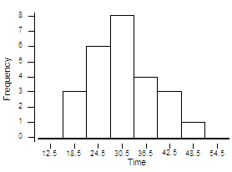
Example 2.9: The following is a histogram for the frequency distribution in example 2.4.
Figure: Distribution of number of minutes spent by the automobile workers

Slide 55
Frequency polygon: is a graphic form of a frequency distribution. It can be constructed by plotting the class frequencies against class marks and joining them by a set of line segments.
Note: we should add two classes with zero frequencies at the two ends of the frequency distribution to complete the polygon.

Slide 56
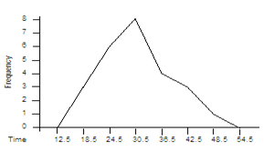
Example 2.10: Construct a frequency polygon for the frequency distribution of the time spent by the automobile workers that we have seen in example 2.4
Figure: Distribution of number of minutes spent by the automobile workers

Slide 57
Graphs useful for presenting qualitative data
Bar charts are diagrammatic representation of data in which the data are represented by series of vertical or horizontal bars, the height (or length) of each bar indicating the size of the figure represented.
Example 2.11: Draw a bar chart for the following coffee production data.

Slide 58
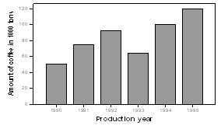
Table: Coffee productions from 1990 to 1995.
Production year | 1990 | 1991 | 1992 | 1993 | 1994 | 1995
Amounts of coffee (in 1000 tons) | 50 | 75 | 92 | 64 | 100 | 120

Slide 59


Pie-chart: it is a circle divided by radial lines into sections or sectors so that the area of each sector is proportional to the size of the figure represented.
Pie-chart construction:
Calculate the percentage frequency of each component. It is given by
Calculate the degree measures of each sector. It is given by
Then draw the circle.

Slide 60
Example 2.13: Draw a pie-chart to represent the following data on a certain family expenditure.
Table: Family expenditure.
Item | Food | Clothing | House rent | Fuel & light | Miscellaneous | Total
Expenditure(in birr) | 50 | 30 | 20 | 15 | 35 | 150
Percentage frequencies | 33.33 | 20 | 13.33 | 10 | 23.33
Angles of the sector | 120⁰ | 72⁰ | 48⁰ | 36⁰ | 84⁰ | 3600

Slide 61
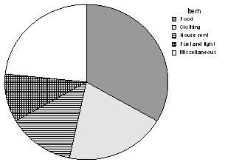
Figure: Family expenditure

Slide 62
Thank you!

Slide 63
MEASURES OF CENTRAL TENDENCY
By Mulugeta G. (BSc, MPH)
Email: mullergaro@gmail.com
2021/2022

Slide 64
Introduction and objectives of measuring central tendency
In the pervious section, we have discussed how raw data can be organized in terms of tables, charts and frequency distributions in order to be easily understood and analyzed.
Frequency distributions and their corresponding graphical displays roughly tell us some of the features of a data set.
However, they don’t condense the mass of data in a way that we can easily understand and interpret.
In this section, we will see how to summarize data using a descriptive measure called average. This will help us in condensing a mass of data into a single value which is in some sense representative of the whole data set.

Slide 65
An average is a single value intended to represent a distribution as a whole.
Note that the individual values of the distribution must have a tendency to cluster around an average. In view of this requirement an average is also referred to as a measure of central tendency.

Slide 66
An average (a measure of central tendency) is considered satisfactory if it possesses all or most of the following properties. An average should be:
Rigidly defined (unique),
Based on all observation under investigation
Easily understood,
Simple to compute
Suitable for further mathematical treatment
Little affected by fluctuations of sampling
Not highly affected by extreme values.

Slide 67
The summation notation
Suppose a variable is represented by X. The successive values of this variable may be represented by using subscripts or indexes as x₁, x₂, x₃,…, x_{n}. If the sum of these values or terms is required, we write x₁+x₂+x₃+…+x_{n}. The Greek letter ∑ (read as sigma) can be used to write the above sum in a compact form as
where 1= lower limit and n = upper limit.

Slide 68
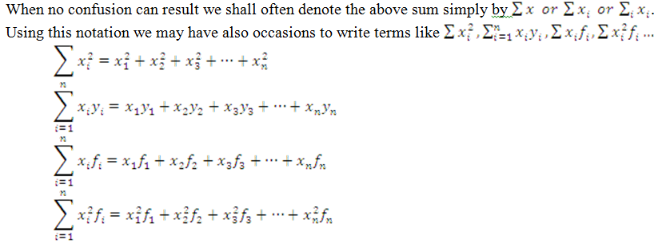

Slide 69
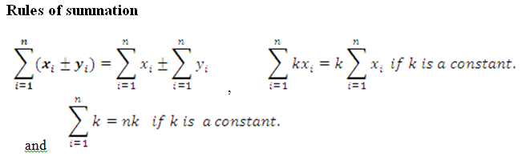

Slide 70
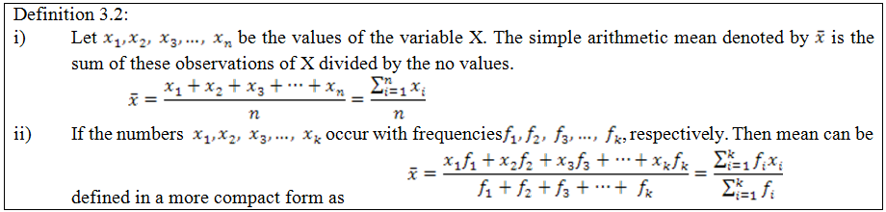
Types of measures of central tendency
Arithmetic mean
Note that if the data refers to a population data the mean is denoted by the Greek letter µ (read as mu).

Slide 71

Arithmetic mean for raw data (ungrouped data)
Example 3.1: The following data is the weight (in Kg) of eight youths: 32,37,41,39,36,43,48 and 36. Calculate the arithmetic mean of their weight.

Slide 72
Example 3.2: The ages of a random sample of patients in a given hospital in Ethiopia is given below:
Calculate the average age of these patients.
Solution:
Age | 10 | 12 | 14 | 16 | 18 | 20 | 22
Number of patients | 3 | 6 | 10 | 14 | 11 | 5 | 4

Slide 73
Age (x_{i}) | Number of patients (f_{i}) | fixi
10 | 3 | 30
12 | 6 | 72
14 | 10 | 140
16 | 14 | 224
18 | 11 | 198
20 | 5 | 100
22 | 4 | 88
Total | 53 | 852

Slide 74
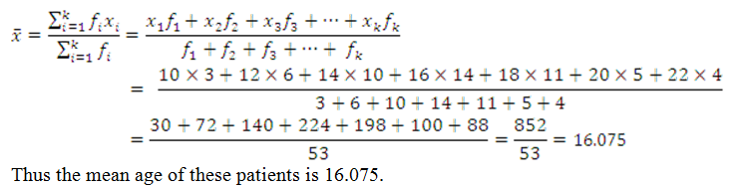

Slide 75
The weighted arithmetic mean
In some cases the data in the sample or population should not be weighted equally, and each value weighted according to its importance.
There is a measure of average for such problems known as weighted Arithmetic mean.
Weighted arithmetic mean is used to calculate the average when the relative importance of the observations differs.
This relative importance is technically known as weight.
Weight could be a frequency or numerical coefficient associated with observations.

Slide 76
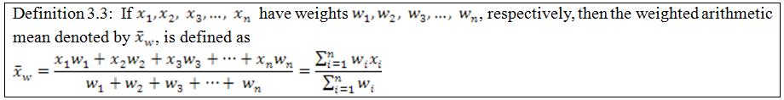

Slide 77
Example 3.3: The GPA or CGPA of a student is a good example of a weighted arithmetic mean. Suppose that Solomon obtained the following grades in the first semester of the freshman program at AASTU in 2006.
Course | Credit hour (w_{i}) | Grade
Math101 | 4 | A=4
Stat2091 | 3 | C=2
Chem101 | 3 | B=3
Phys101 | 4 | B=3
Flen101 | 3 | C=2

Slide 78

Find the GPA of Solomon.

Slide 79

Properties of arithmetic mean
It can be computed for any set of numerical data, it always exists, and unique.
It depends on all observations.
The sum of deviations of the observations about the mean is zero i.e.

Slide 80
It is greatly affected by extreme values.
It lends itself to further statistical treatment, for instance, combinations of means.
It is relatively reliable, i.e. it is not greatly affected by fluctuations in sampling.
The sum of squares of deviations of all observations about the mean is the minimum

Slide 81
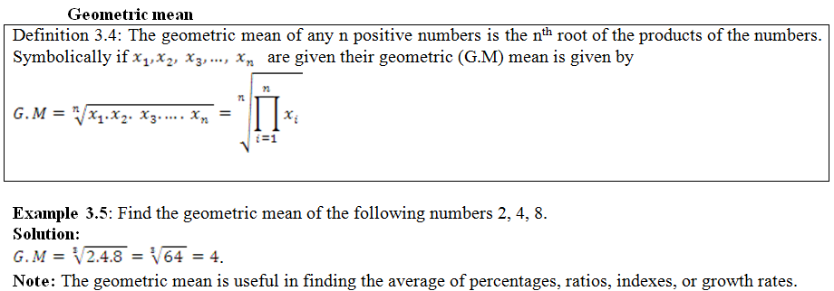

Slide 82
Example 3.6: During the beginning of an epidemic in a region 12 cases were reported in the first day, 18 on second day and 48 on the third day.
Find the average growth rate of the epidemic disease.
Assuming that the growth pattern continues, forecast the number of cases that would be reported on the 4th and 8th days.
Solution:
Find the 2 growth rates first.
From first day to second day the rate is 18/12=1.5.
From second day to third day the rate is 48/18=2.67.

Slide 83

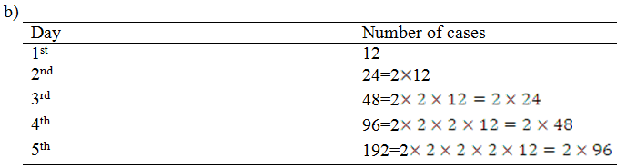
The case of the next day is twice (by rate) of the previous day
Therefore, the average rate
.
Notes:
2n*12 the number of cases will be double on the consecutive day, the number of cases on the next day is the double of the previous day

Slide 84
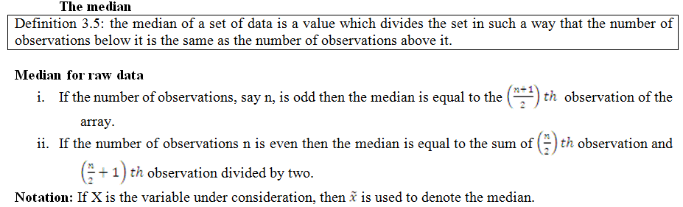

Slide 85
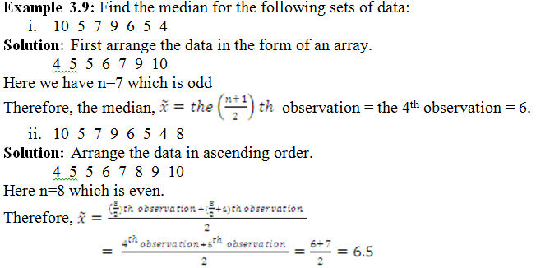

Slide 86
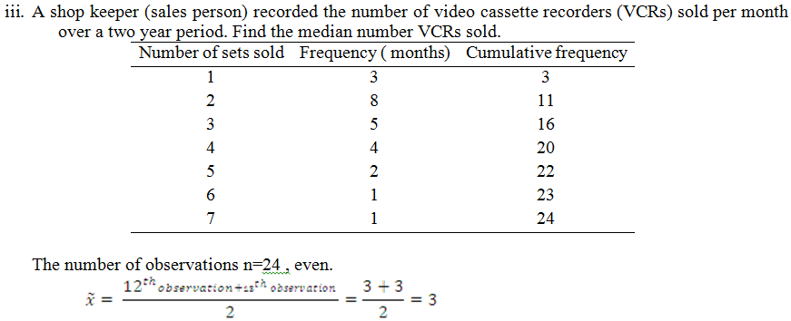

Slide 87
Find the median and mean value
XI | frequency
5 | 2
2 | 6
3 | 3
8 | 6
1 | 1
9 | 4
4 | 1

Slide 88
Properties of median
It is an average of position.
It is affected by the number of observations than by extreme values.
The sum of the deviations about the median, signs ignored, is less than the sum of deviations taken from any other value or specific average.

Slide 89
Definition 3.6: The mode (modal value) of an observed set of data is the value that occurs the largest number of times.
The mode for raw data
Example 3.10: Find the modal value for the following sets of data.
5 6 5 8 7 4 . In this data set, 5 is the most frequent value. Therefore, the mode is 5. Since the modal value is only one number, we call the distribution unimodal.
1 2 3 4 8 2 5 4 6. In this data the modal values are 2 and 4 since both 2 and 4 appear most frequently and they occur equal number of times. These kind distributions are called bimodal distribution.
1 2 4 3 5 6 8 7 In this data set, all values appear equal number of times so there is no modal value

Slide 90
Note:
If a distribution has more than two modal values then we call the distribution multimodal.
If in a set of observed values, all values occur once or equal number of times, there is no mode.

Slide 91
Properties of modal value
It is easy to calculate and understand.
It is not affected by extreme values.
It is not based on all observations.
Is not used in further analysis of data.

Slide 92
The mean, median, and mode of grouped data
The mean for grouped data can be found by considering the values in the interval are centered at the mid-point of the interval.
Example 3.12: Consider the frequency distribution of the time spent by the automobile workers. Find the mean time spent by these workers from this frequency distribution.

Slide 93
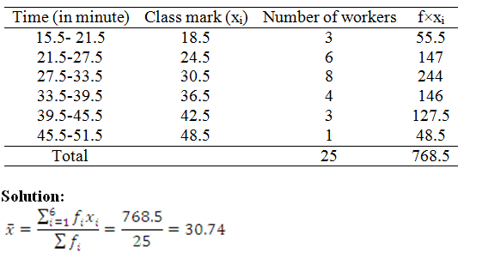

Slide 94
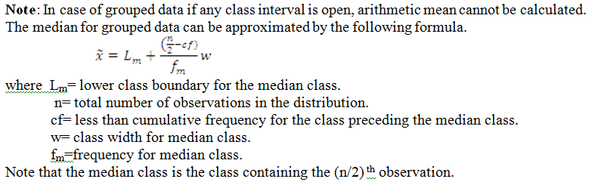

Slide 95
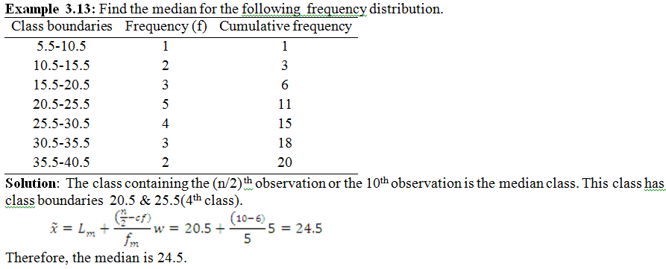

Slide 96
Note:
We approximate the median by assuming that the values in the median class are evenly distributed.
We can compute the median for open-ended frequency distribution as long as the middle value does not occur in the open-ended class.

Slide 97
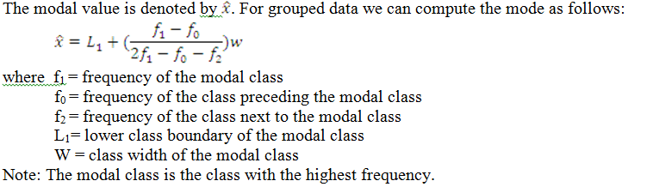
The mode for grouped data can be estimated by the following formula.

Slide 98
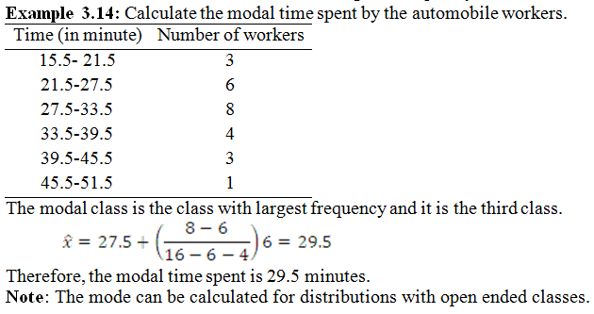

Slide 99
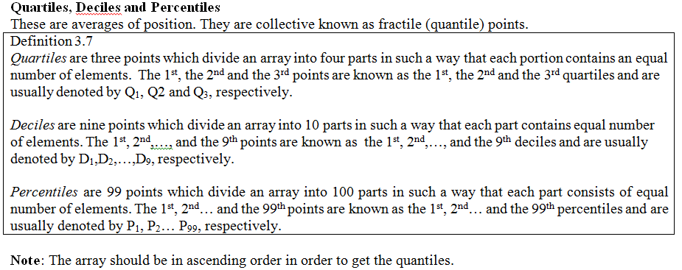

Slide 100
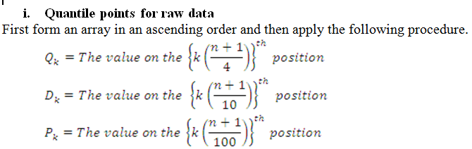

Slide 101
Example 3.15: The following data relate to sizes of shoes sold at a stock during a week. Find the quartiles, the seventh decile and the 90th percentile.
Solution: The total number of observations is 191.
Size of shoes | 5 | 5.5 | 6 | 6.5 | 7 | 7.5 | 8 | 8.5 | 9 | 9.5
Number of pairs | 2 | 5 | 15 | 30 | 60 | 40 | 23 | 11 | 4 | 1

Slide 102
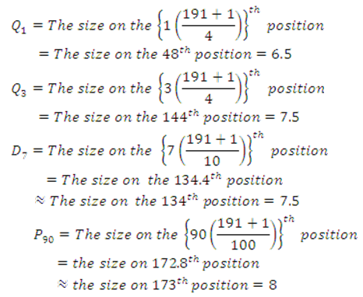

Slide 103
Note: Relationships between fractile points
Q₁=P₂₅
Q₂=P₅₀=D₅
Q₃=P₇₅
D₁=P₁₀; D2=P₂₀ …D₉=P₉₀.

Slide 104
4 2 4 3 2 8 3 4 4 2 2 8 5 3 4
. Calculate sample: mean, variance and SD
. Calculate Coefficient of variation
. Calculate standard score for x=7 and interpret the result
. Calculate the forth moment about the mean
. Calculate personian coefficient of skewness and state the type of distribution
Calculate Moment coeficient of kurtosis and state the type of distribution

Slide 105
Thank you!

Slide 106
MEASURES OF VARIATION

Slide 107
Objectives: Having studied this portion, you should be able to
understand the importance of measuring the variability (dispersion) in a data set.
measure the scatter or dispersion in a data set.
measure the extent to which the distribution of values in a data set deviate from symmetry.

Slide 108
Introduction and objectives of measuring variation
We have seen that averages are representatives of a frequency distribution. But they fail to give a complete picture of the distribution. They do not tell anything about the spread or dispersion of observations within the distribution. Suppose that we have the distribution of yield (kg per plot) of two rice varieties from 5 plots each.
Variety 1: 45 42 42 41 40
Variety 2: 54 48 42 33 30

Slide 109
The mean yield of both varieties is 42 kg. The mean yield of variety 1 is close to the values in this variety.
On the other hand, the mean yield of variety 2 is not close to the values in variety 2.
The mean doesn’t tell us how the observations are close to each other

Slide 110
Objectives of measuring variation
To describe dispersion (variability) in a data.
To compare the spread in two or more distributions.
To determine the reliability of an average.
Note: The desirable properties of good measures of variation are almost identical with that of a good measure of central tendency.

Slide 111
Absolute and relative measures
Measures of variation may be either absolute or relative.
Absolute measures of variation are expressed in the same unit of measurement in which the original data are given. These values may be used to compare the variation in two distributions provided that the variables are in the same units and of the same average size.

Slide 112
In case the two sets of data are expressed in different units, however, such as quintals of sugar versus tones of sugarcane or if the average sizes are very different such as manager’s salary versus worker’s salary, the absolute measures of dispersion are not comparable.
In such cases measures of relative dispersion should be used.
A measure of relative dispersion is the ratio of a measure of absolute dispersion to an appropriate measure of central tendency.
It is a unit less measure.

Slide 113
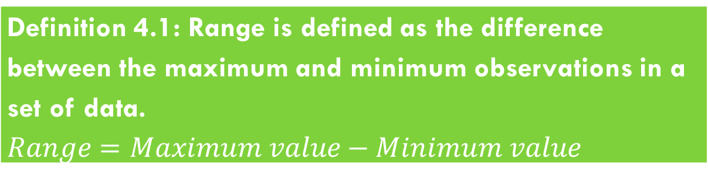
Types of measures of variation
The range and relative range
Definition 4.1: Range is defined as the difference between the maximum and minimum observations in a set of data. $Range=Maximum value−Minimum value$

Slide 114
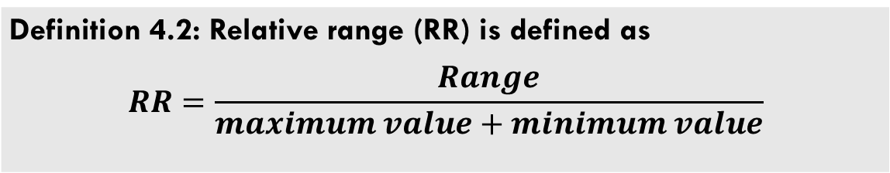
Range is the crudest absolute measures of variation. It is widely used in the construction of quality control charts.
Definition 4.2: Relative range (RR) is defined as $$RR=\frac{Range}{maximum value+minimum value}$$

Slide 115
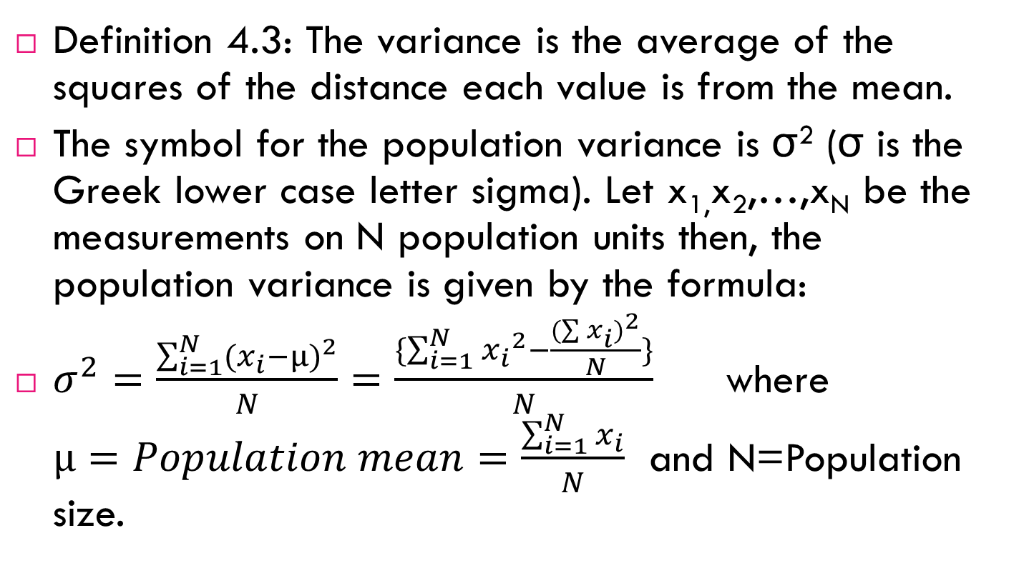
Variance, standard deviation and coefficient of variation
Definition 4.3: The variance is the average of the squares of the distance each value is from the mean.
The symbol for the population variance is σ² (σ is the Greek lower case letter sigma). Let x_{1,}x₂,…,x_{N} be the measurements on N population units then, the population variance is given by the formula:
$σ^{2}=\frac{\sum_{i=1}^{N}{{{(x}_{i}−µ)}^{2}}}{N}=\frac{\{\sum_{i=1}^{N}{{x_{i}}^{2}−\frac{{(\sum{x_{i}})}^{2}}{N}\}}}{N}$ where $µ=Population mean=\frac{\sum_{i=1}^{N}{x_{i}}}{N}$ and N=Population size.

Slide 116
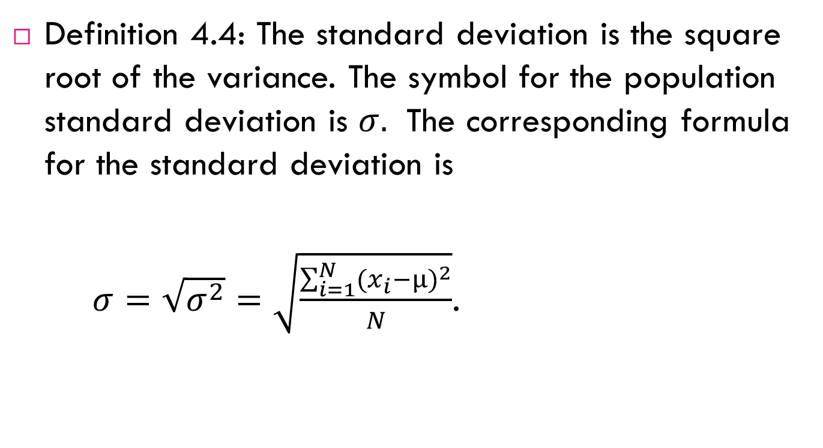
Definition 4.4: The standard deviation is the square root of the variance. The symbol for the population standard deviation is $σ.$ The corresponding formula for the standard deviation is
$σ=\sqrt{σ^{2}}=\sqrt{\frac{\sum_{i=1}^{N}{{{(x}_{i}−µ)}^{2}}}{N}}$.

Slide 117
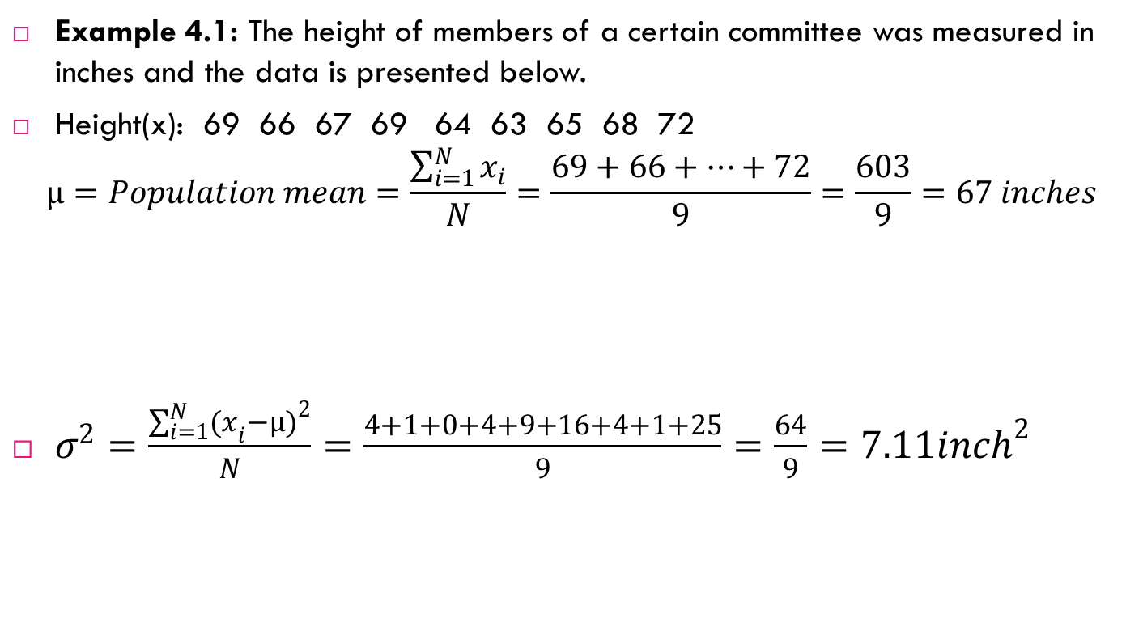
Example 4.1: The height of members of a certain committee was measured in inches and the data is presented below.
Height(x): 69 66 67 69 64 63 65 68 72
$$µ=Population mean=\frac{\sum_{i=1}^{N}{x_{i}}}{N}=\frac{69+66+…+72}{9}=\frac{603}{9}=67 inches$$
$σ^{2}=\frac{\sum_{i=1}^{N}{{{(x}_{i}−µ)}^{2}}}{N}=\frac{4+1+0+4+9+16+4+1+25}{9}=\frac{64}{9}=7.11{inch}^{2}$
$$(x−µ)$$ | 2 | -1 | 0 | 2 | -3 | -4 | -2 | 1 | 5
$${(x−µ)}^{2}$$ | 4 | 1 | 0 | 4 | 9 | 16 | 4 | 1 | 25

Slide 118
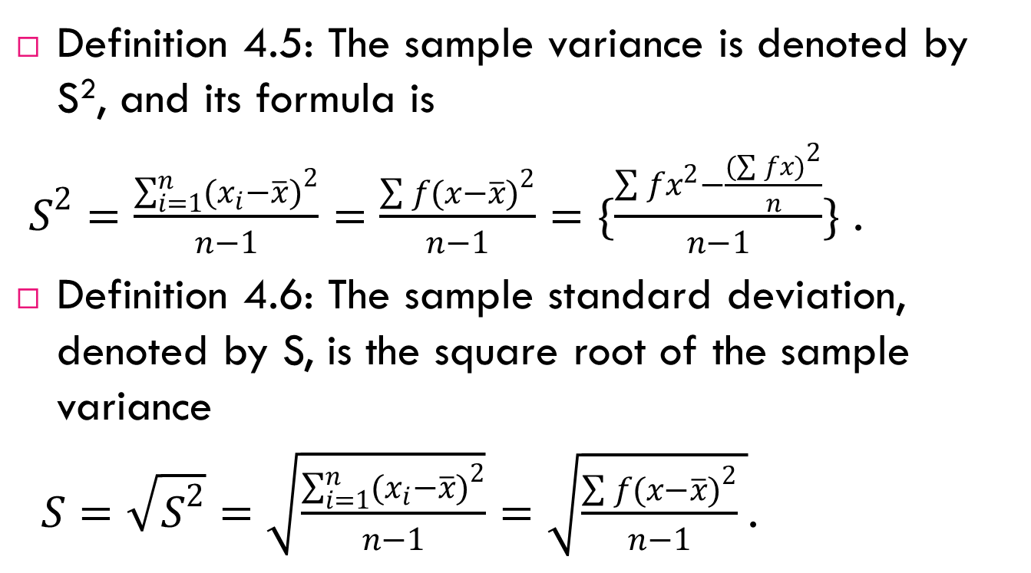
Definition 4.5: The sample variance is denoted by S², and its formula is
$S^{2}=\frac{\sum_{i=1}^{n}{{(x_{i}−\overline{x})}^{2}}}{n−1}=\frac{\sum{f{(x−\overline{x})}^{2}}}{n−1}=\{\frac{\sum{fx^{2}−\frac{{(\sum{fx)}}^{2}}{n}}}{n−1}\}$ .
Definition 4.6: The sample standard deviation, denoted by S, is the square root of the sample variance
$S=\sqrt{S^{2}}=\sqrt{\frac{\sum_{i=1}^{n}{{(x_{i}−\overline{x})}^{2}}}{n−1}}=\sqrt{\frac{\sum{f{(x−\overline{x})}^{2}}}{n−1} }$.

Slide 119
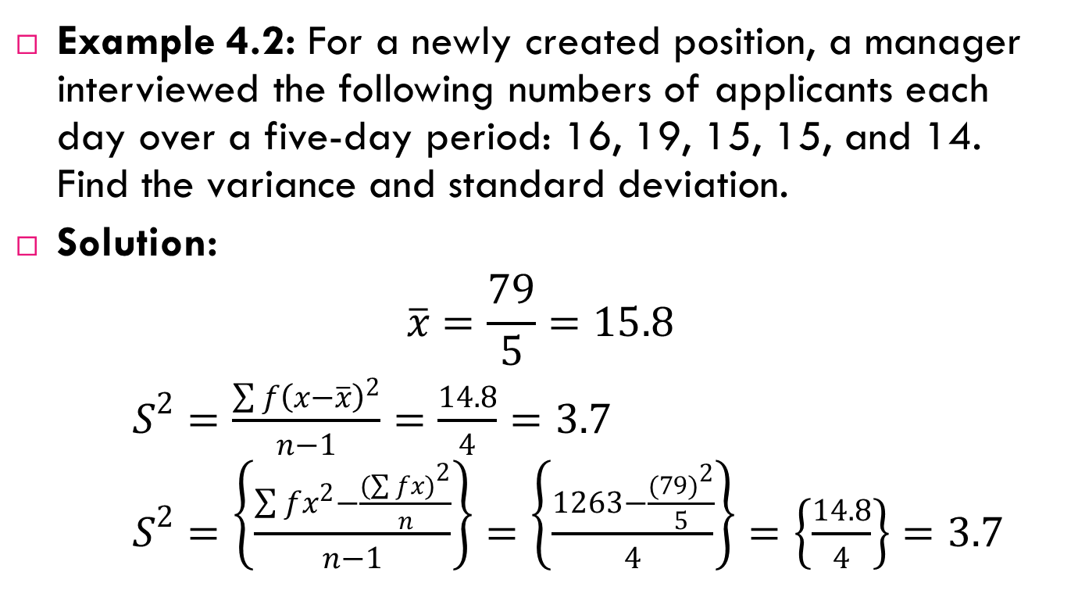
Example 4.2: For a newly created position, a manager interviewed the following numbers of applicants each day over a five-day period: 16, 19, 15, 15, and 14. Find the variance and standard deviation.
Solution:
$$\overline{x}=\frac{79}{5}=15.8$$
$$S^{2}=\frac{\sum{f{\left(x−\overline{x}\right)}^{2}}}{n−1}=\frac{14.8}{4}=3.7$$
$$S^{2}=\left\{\frac{\sum{fx^{2}−\frac{{(\sum{fx)}}^{2}}{n}}}{n−1}\right\}=\left\{\frac{1263−\frac{{(79)}^{2}}{5}}{4}\right\}=\left\{\frac{14.8}{4}\right\}=3.7$$

Slide 120
Note that the procedure for finding the variance and standard deviation for grouped data is similar to that for finding the mean for grouped data, and it uses the mid-points of each class.

Slide 121
Find sample variance and standard deviation for the following data

Slide 122
Properties of variance
The unit of measurement of the variance is the square of the unit of measurement of the observed values. It is one of its limitations.
The variance gives more weight to extreme values as compared to those which are near to mean value, because the difference is squared in variance.
It is based on all observations in the data set.

Slide 123
Properties of standard deviation
Standard deviation is considered to be the best measure of dispersion and is used widely.
There is, however, one difficulty with it. If the unit of measurement of variables of two series is not the same, then their variability cannot be compared by comparing the values of standard deviation.

Slide 124
Uses of the variance and standard deviation
The variance and standard deviations can be used to determine the spread of data, consistency of a variable and the proportion of data values that fall within a specified interval in a distribution.
If the variance or standard deviation is large, the data is more dispersed.
This information is useful in comparing two or more data sets to determine which is more (most) variable.
Finally, the variance and standard deviation are used quite often in inferential statistics.

Slide 125

Coefficient of variation (CV)
The standard deviation is an absolute measure of dispersion. The corresponding relative measure is known as the coefficient of variation (CV).
Coefficient of variation is used in such problems where we want to compare the variability of two or more different series. Coefficient of variation is the ratio of the standard deviation to the arithmetic mean, usually expressed in percent:
A distribution having less coefficient of variation is said to be less variable or more consistent or more uniform or more homogeneous.

Slide 127
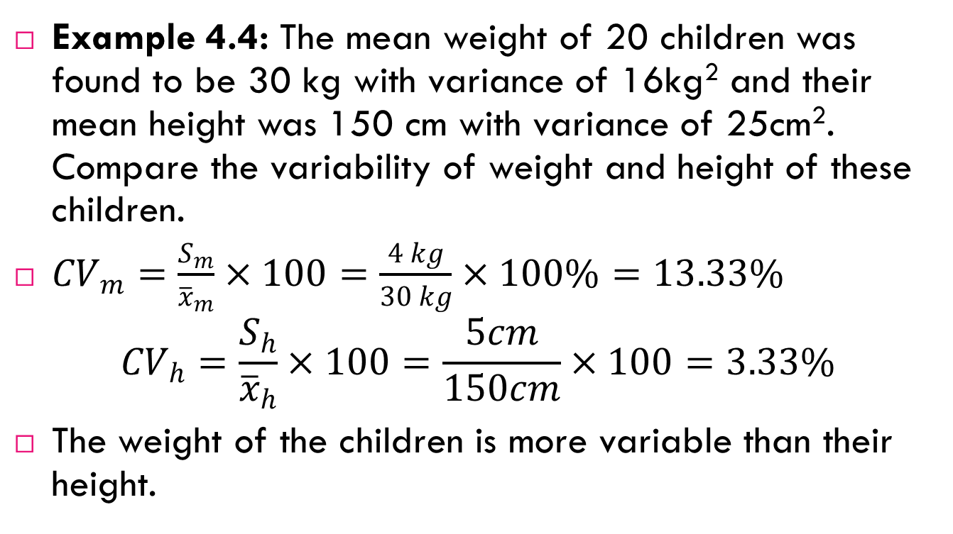
Example 4.4: The mean weight of 20 children was found to be 30 kg with variance of 16kg² and their mean height was 150 cm with variance of 25cm². Compare the variability of weight and height of these children.
${CV}_{m}=\frac{S_{m}}{{\overline{x}}_{m}}×100=\frac{4 kg}{30 kg}×100\%=13.33\%$
$${CV}_{h}=\frac{S_{h}}{{\overline{x}}_{h}}×100=\frac{5cm}{150cm}×100=3.33\%$$
The weight of the children is more variable than their height.

Slide 128
Standard score

Slide 129

Interpretation:
$$If Z is \left\{ \begin{aligned}positive, the observation lies above the mean \\ negative, the observation lies below the mean \\ zero, the observation equals to the mean \end{aligned} \right.$$

Slide 131
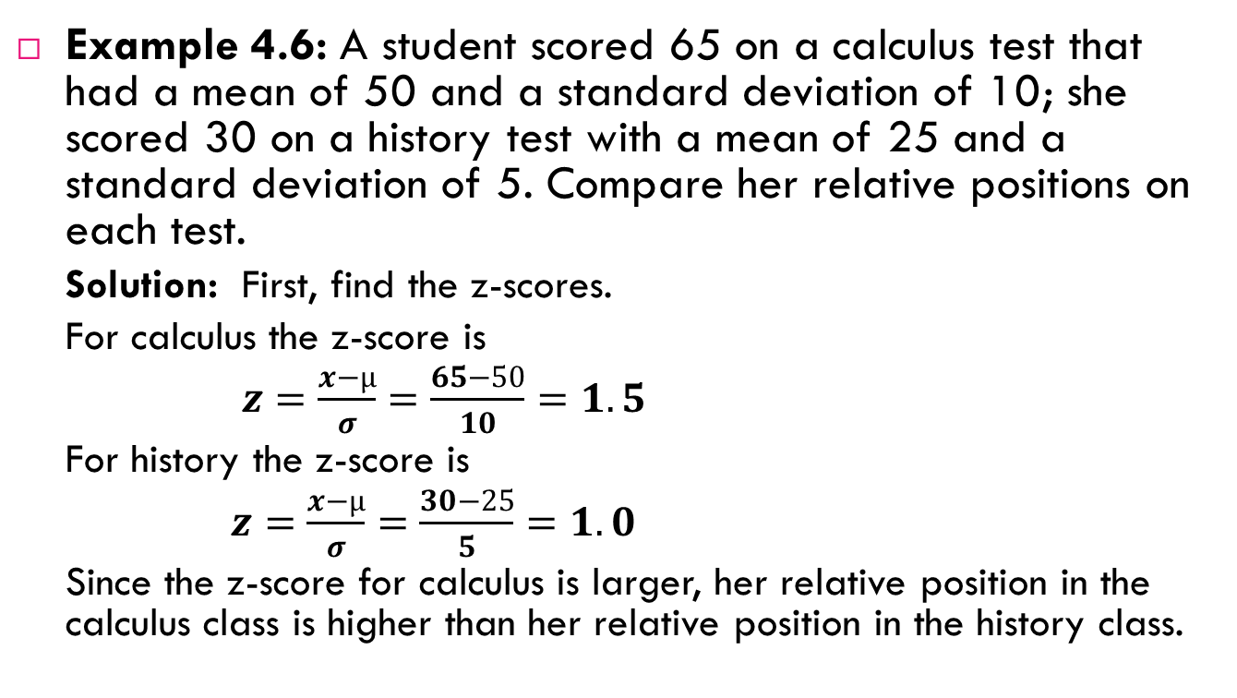
Example 4.6: A student scored 65 on a calculus test that had a mean of 50 and a standard deviation of 10; she scored 30 on a history test with a mean of 25 and a standard deviation of 5. Compare her relative positions on each test.
Solution: First, find the z-scores.
For calculus the z-score is
$$z=\frac{x−µ}{σ}=\frac{65−50}{10}=1.5$$
For history the z-score is
$$z=\frac{x−µ}{σ}=\frac{30−25}{5}=1.0$$
Since the z-score for calculus is larger, her relative position in the calculus class is higher than her relative position in the history class.

Slide 132
Skewness and kurtosis

Slide 133
Skewness: it refers to lack of symmetry in a distribution.
Note: for a symmetrical and unimodal distribution:
Mean =median =mode
The lower and upper quartiles are equidistant from the median, so also are corresponding pairs of deciles and percentiles.
Sum of positive deviations from the median is equal to the sum of negative deviations (signs ignored).
The two tails of the frequency curve are equal in length from the central value.
If a distribution is not symmetrical we call it skewed distribution.

Slide 134

Measures of skewness
Pearsonian coefficient of skewness (P_{csk}) defined as:
$P_{csk}=\frac{mean−mode}{s.d}$

Slide 135
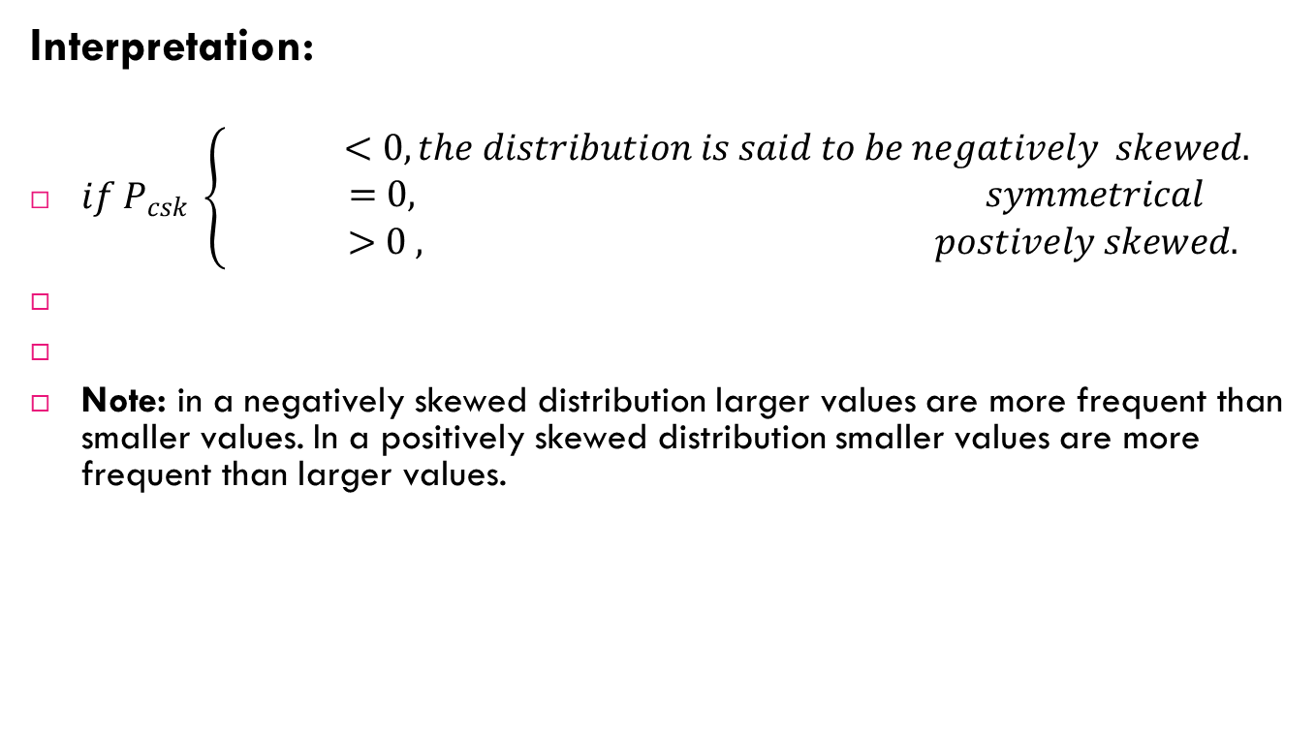
Interpretation:
$if P_{csk} \left\{ \begin{matrix} <0, the distribution is said to be negatively skewed. \\ =0, symmetrical \\ >0 , postively skewed.\end{matrix} \right.$
Note: in a negatively skewed distribution larger values are more frequent than smaller values. In a positively skewed distribution smaller values are more frequent than larger values.

Slide 136
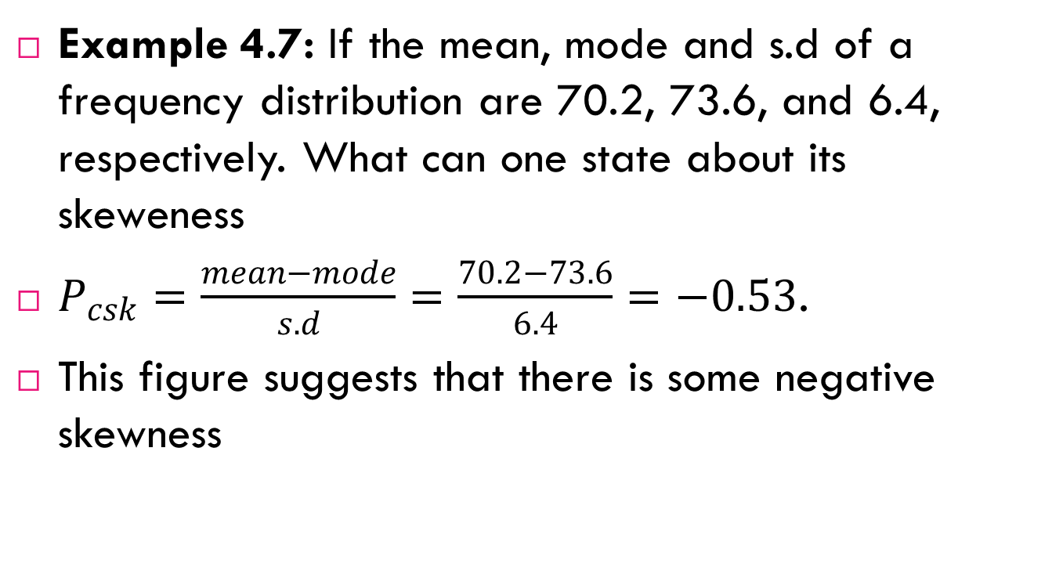
Example 4.7: If the mean, mode and s.d of a frequency distribution are 70.2, 73.6, and 6.4, respectively. What can one state about its skeweness
$P_{csk}=\frac{mean−mode}{s.d}=\frac{70.2−73.6}{6.4}=−0.53$.
This figure suggests that there is some negative skewness

Slide 137
Kurtosis: it refers to the degree of peakedness of a distribution.

Slide 138
When the values of a distribution are closely bunched around the mode in such a way that the peak of the distribution becomes relatively high, the distribution is said to be leptokurtic. If it is flat topped we call it platykurtic. A distribution which is neither highly peaked nor flat topped is known as a meso-kurtic distribution (normal).

Slide 139
Measures of kurtosis

Slide 140
ELEMENTARY PROBABILITY

Slide 141
Definition of some probability terms
Random experiment: is an experiment in which the outcome cannot be determined or predicted exactly in advance, i.e. it is the process of observing or measuring the outcome of a chance event.
Some of the characteristics of a random experiment are:
all the possible outcomes of the experiment can be specified in advance.
the experiment can be repeated indefinitely.
there is a sort of regularity in the outcomes observed in large repetitions of the experiment.

Slide 142
Sample point (outcome): The individual result of a random experiment.
Sample space: The set containing all possible sample points (out comes) of the random experiment.
The sample space is often called the universe and denoted by S.
Event: The collection of outcomes or simply a subset of the sample space. We denote events with capital letters, A, B, C, etc.

Slide 143
Example 5.1: If an experiment consists of flipping of a coin once, then
S = {H, T} where H means that the outcome of the toss is a head and T that it is a tail. A= {H} represents the event of head occurring.
Example 5.2: If an experiment consists of rolling a die once and observing the number on top, then the sample space is S = {1, 2, 3, 4, 5, 6} where the outcome i means that i appeared on the die, i = 1, 2, 3, 4, 5, 6. {1}, {2},{3},{4},{5} and {6}are elementary events i.e. events consisting of a single outcome. Let A represents the event of an odd number will occur, then A is simply the set containing 1, 3 and 5 i.e. A= {1, 3, 5}.

Slide 144
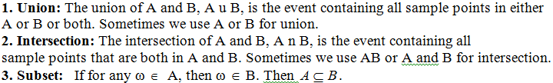

Slide 145
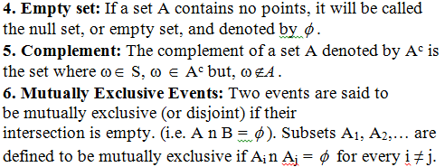

Slide 146
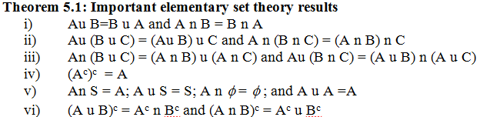

Slide 147
Counting rules
to assign probabilities for an event, we might need to enumerate the possible outcomes of a random experiment and need to know the number of possible outcomes favoring the event. The following principles will help us in determining the number of possible outcomes favoring a given event.

Slide 148
Addition principle
If a task can be accomplished by k distinct procedures where the i^{th} procedure has n_{i} alternatives, then the total number of ways of accomplishing the task equals n₁ + n₂+…+n_{k}.
Example 5.3: Suppose one wants to purchase a certain commodity and that this commodity is on sale in 5 government owned shops, 6 public shops and 10 private shops. How many alternatives are there for the person to purchase this commodity?
Solution: Total number of ways =5+6+10=21 ways

Slide 149
Multiplication principle
If a choice consists of k steps of which the first can be made in n₁ ways, for each of these the second can be made in n₂ ways,…, and for each of these the k^{th} can be made in n_{k} ways, then the whole choice can be made in n₁.n₂….n_{k} ways.
Example 5.4: If we can go from Addis Ababa to Rome in 2 ways and from Rome to Washington D.C. in 3 ways then the number of ways in which we can go from Addis Ababa to Rome to Washington D.C. is 2x3 ways or 6 ways. We may illustrate the situation by using a tree diagram below:

Slide 150
W
R
W
W
A
W
R
W
W

Slide 151
Example 5.5: If a test consists of 10 multiple choice questions, with each permitting 4 possible answers, how many ways are there in which a student gives his/her answers?
Solution: There are 10 steps required to complete the test.
First step: To give answer to question number one. He/she has 4 alternatives.
Second step: To give answer to question number two, he/she has 4 alternatives……
Last step: To give answer to last question, he/she has 4 alternatives.
Therefore, he/she has 4x4x4x…x4=4¹⁰ ways or1, 048, 576 ways of completing the exam. Note that there is only one way in which he/she can give correct answers to all questions and that there are 3¹⁰ ways in which all the answers will be incorrect.

Slide 152
Example 5.6: A manufactured item must pass through three control stations. At each station the item is inspected for a particular characteristic and marked accordingly. At the first station, three ratings are possible while at the last two stations four ratings are possible. Hence there are 48 ways in which the item may be marked.
Example 5.7: Suppose that car plate has three letters followed by three digits. How many possible car plates are there, if each plate begins with a H or an F?
2x 26x 26x 10x 10x 10 or 1, 352, 000 different plates.

Slide 153
If n is a positive integer, we define n!= n(n-1)(n-2)…1 and call it n-factorial and 0!=1.
Permutations
Suppose that we have n different objects. In how many ways, say _{n}P_{n}, may these objects be arranged (permuted)? For example, if we have objects a, b and c we can consider the following arrangements: abc, acb, bac, bca, cab, and cba. Thus the answer is 6. The following theorem gives general result on the number of such arrangements.

Slide 154
Theorem 5.4: Permutation
The number of permutations of n different objects is given by _{n}P_{n}= n!
A permutation of n objects, arranged in groups of size r, without repetition, and order being important is:

Slide 155
Example 5.8: Suppose that we have four letters a, b, c, d.
What is the number of possible arrangements of these letters taken all at a time?
What is the number of possible arrangements of these letters if we use only three of the letters at a time?

Slide 156
Solution:
Using (i) of theorem 5.4, we have 4! ways of arranging the 4 letters, i.e. we have 24 possible arrangements.
Using (ii) of theorem 5.4, we have ₄P₃ ways of arranging 3 letters taken from the four letters, i.e. we have 24 possible arrangements.

Slide 157
Example 5.9: In a class with 8 boys and 8 girls
In how many ways can the children line up if they alternate girl-boy-girl-boy-... ?
In how many ways can the children line up so that no two of the same sex are next to each other?
Solution:
The 8 girls can line-up in 8! ways, and likewise the 8 boys can line-up in 8! ways. For any single arrangement of the girls, all possible arrangements of the boys are possible, thus by multiplication principle we have 8!x 8! ways to arrange the children in girl-boy lines.
Now we must include the case of boy-girl. So we have 2x8!x 8! ways of arranging.

Slide 158

ii) Permutations when not all objects are different
Given n objects of which n₁ are one kind, n₂ are another kind, …, n_{k} of another kind, then the total number of distinct permutations that can be made from these objects is

Slide 159
Example 5.11
How many "words" (text strings or distinct arrangements) can be made from the letters b,k,o,o?
How many permutations are there for the letters in the word banana?

Slide 160
If we label the two o’s as o₁ and o₂, and think of them as distinct, then the number of permutations is 4!. For each permutation there will be a matching permutation that switches the o’s, that is for o₁o₂bk there is the matching o₂o₁bk permutation. We can see then that if we divide the number of distinct permutations by two, we have a count of the number of permutations of the 4 letters where we do not distinguish between the two o’s. Therefore, there are distinct4!/2 text strings or 12 text strings.

Slide 161

If we think of all 6 letters as distinct, then we would have 6! permutations. As in the preceding example for the two n’s, we would need to divide 6! by 2. For the 3 a’s, we would have 6 counts for a single permutation. For instance, each of the following would be a single word if the a’s were not distinct. a₁a₂a₃bnn, a₁a₃a₂bnn, a₂a₁a₃bnn, a₂a₃a₁bnn, a₃a₁a₂bnn, and a₃a₂a₁bnn. Hence the number of distinct permutations of the word banana is
.

Slide 162
Combinations
Consider n different objects. This time we are concerned with counting the number of ways we may choose r out of these n objects without regard to order. For example, we have the objects a, b, c and d, and r=2; we wish to count ab, ac, ad, bc, bd, and cd. In other words, we do not count ab and ba since the same objects are involved and only the order differs.

Slide 163
There are many problems in which we are interested in determining the number of ways in which r objects can be selected from n distinct objects without regard to the order in which they are selected. Such selections are called combinations or r-sets. It may help to think of combinations as committees. The key here is without regard for order.

Slide 164


Slide 165
Example 5.12: How many different committees of 3 can be formed from Hawa, Segenet, Nigisty and Lensa?
Solution: The question can restated in terms of subsets from a set of 4 objects, how many subsets of 3 elements are there? In terms of combinations the question becomes, what is the number of combinations of 4 distinct objects taken 3 at a time? The list of committees:{H,S,N}, {H,S,L}, {H,N,L}, {S,N,L}.Therefore, we have ₄C₃ or 4 possible number of committees.

Slide 166
Example 5.13:
(i) A committee of 3 is to be formed from a group of 20 people. How many different committees are possible?
(ii) From a group of 5 men and 7 women, how many different committees consisting of 2 men and 3 women can be formed?

Slide 167
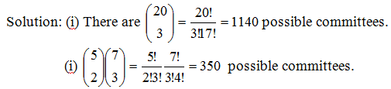

Slide 168
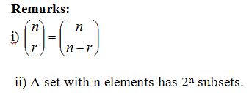

Slide 169
The Axioms of Probability
Probabilities are real numbers assigned to events (or subsets) of a sample space. We can think of the assignment of probabilities to events, or probability measure, as a function between the collection of subsets of the sample space and the real numbers.

Slide 170
Mathematically, a probability measure P for a random experiment is a real-valued function defined on the collection of events that satisfies the following axioms:
Axiom 1: The probability of an event is a nonnegative real number; that is, P(A) ≥ 0 for any subset A of S.
Axoim 2: P(S) = 1
Axiom 3: If A₁, A₂, A₃ ... is a finite or infinite sequence of mutually exclusive
events of S, then P(A₁ u A₂ u A₃ u ...) = P( A₁) + P( A₂) + P( A₃) + ...=

Slide 171
Suppose that we have a random experiment with sample space S and probability function P and A and B are events. Then we have the following results:
P( ) = 0
P(A^{c}) = 1 − P(A)
P(B n A^{c}) = P(B) − P(A n B)
If A subset of B then P(A) ≤ P(B).

Slide 172

The classical definition of probability
If an experiment can result in any one of N equally likely and mutually exclusive outcomes, and if n of these outcomes constitute the event A, then the probability of event A is

Slide 173
Consider the experiment of tossing a fair die. A fair die means that all six numbers are equally likely to appear. Calculate the probabilities of the following events:
A=One will occur ={1}
B=Even number will occur ={2, 4, 6}
C=Odd number will occur ={1, 3, 5}
D=A number less than 3 will occur ={1,2}

Slide 174
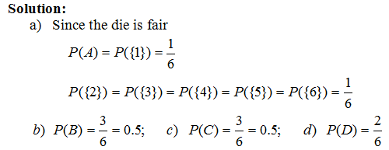

Slide 175
Example 5.15: Suppose that we toss two coins, and assume that each of the four outcomes in the sample space S = {(H,H),(H, T ), (T ,H), (T , T )} are equally likely and hence has probability ¼. Let A = {(H, H),(H, T )} and B = {(H,H), (T ,H)} that is, A is the event that the first coin falls heads, and B is the event that the second coin falls heads. Then, calculate the probabilities of A, B, A^{c}, B^{c}, and S^{c}. The event that none of the outcomes will occur is the same as S^{c}.

Slide 176
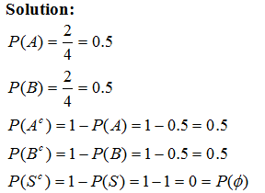

Slide 177
Example 5.16: From a group of 5 men and 7 women, it is required to form a committee of 5 persons. If the selection is made randomly, then
What is the probability that 2 men and 3 women will be in the committee?
What is the probability that all members of the committee will be men?
What is the probability that at least three members will be women?

Slide 178
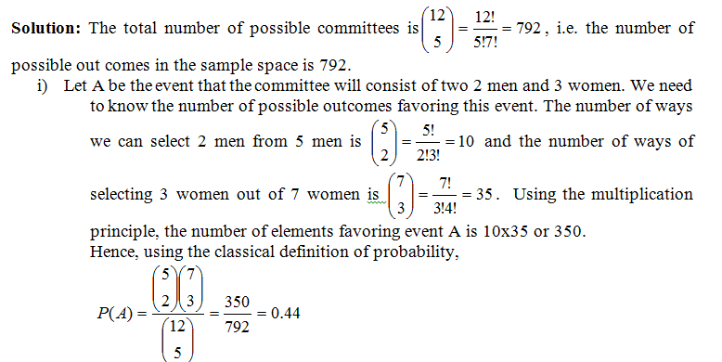

Slide 179
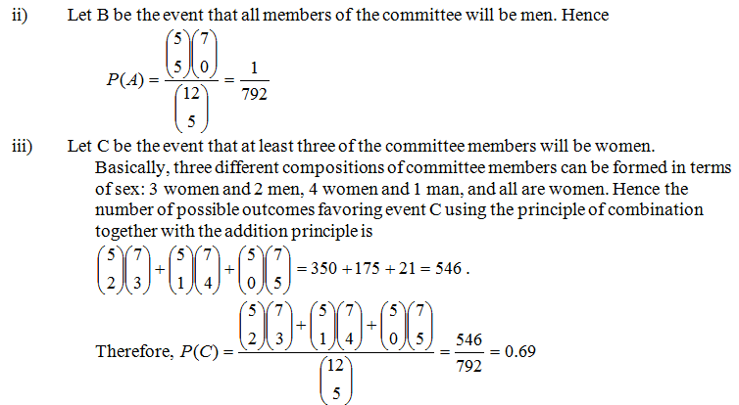

Slide 180
Some probability rules
If A and B , then P(A u B) = P(A) + P(B) − P(A n B).
Example 5.17: Consider the experiment of tossing a fair die. Let
A = Even number occurring = {2,4,6}
B = A number greater than 2 occurring ={3, 4, 5, 6}
C = Odd number occurring ={1, 3, 5}
What is the probability that A and B will occur?
What is the probability that A or B will occur?

Slide 181
Solution: We use the concept of set theory to help us solve probability questions very easily and vein diagrams are useful tools to depict the relations between events within the sample space. The shaded region on Fig 1. shows the event that both A and B will occur.
A and B ≡ AnB ={4,6} Thus P(AnB)=2/6.
A or B ≡ AUB ={2,3,4,5,6} AnB={4,6} Hence,

Slide 182
Example 5.18: Sixty percent of the families in a certain community own their own car, thirty percent own their own home, and twenty percent own both their own car and their own home. If a family is randomly chosen,
what is the probability that this family do not have a car?
what is the probability that this family owns a car or a house?
what is the probability that this family owns a car or a house but not both?
what is the probability that this family owns only a house?
what is the probability that this family neither owns a car nor a house?

Slide 183
Solution: Let A represents that the family owns a car and B represents that the family owns a house. Given information: P(A)=0.6,P(B)=0.3, and P(AnB)=0.2.
Required: P(A^{c}) = ? P(A^{c})=1-P(A) = 1-0.6 = 0.4
Required: P(AUB) = ? P(AUB) = P(A)+P(B)-P(AnB) = 0.6+0.3-0.2 = 0.7
Required: P((AnB^{c})U(A^{c}nB)) = ? P((AnB^{c})U(A^{c}nB)) = P(AnB^{c})+P(A^{c}nB) = [P(A)-P(AnB)]+[P(B)-P(AnB)] = [0.6-0.2]+[0.3-0.2]=0.5

Slide 184
Required: P(A^{c}nB) =? P(A^{c}nB) = P(B)-P(AnB) = 0.3-0.2 = 0.1
Required: P(A^{c}nB^{c}) = ? P(A^{c}nB^{c}) = P((AUB)^{c}) = 1-P(AUB) = 1-0.7 = 0.3

Slide 185
We can represent various events by an informative diagram called vein diagram. If properly and correctly drawn, a vein diagram helps to calculate probabilities of events easily. The figure below shows various events represented by shaded regions. Note that the rectangle in each figure represents the sample space.

Slide 186
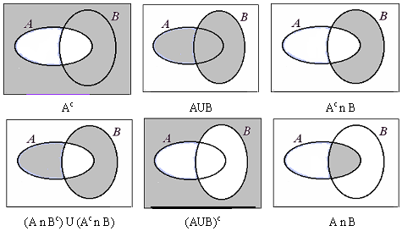

Slide 187
Conditional probability and independence
Conditional Probability
Conditional probability provides us with a way to reason about the outcome of an experiment, based on partial information. Here are some examples of situations we may have in our mind:
(a) What is the probability that a person will be HIV-Positive given he has tuberculosis?
(d) A spot shows up on a radar screen. How likely is it that it corresponds to an aircraft?

Slide 188

If P(B) > 0, the conditional probability of A given B, denoted by P(A|B), is

Slide 189
Example 5.19: Suppose cards numbered one through ten are placed in a hat, mixed up, and then one of the cards is drawn at random. If we are told that the number on the drawn card is at least five, then what is the conditional probability that it is ten?
Solution: Let A denote the event that the number on the drawn card is ten, and B be the event that it is at least five. The desired probability is P(A|B).

Slide 191
Example 5.20: A family has two children. What is the conditional probability that both are boys given that at least one of them is a boy? Assume that the sample space S is given by S = {(b, b), (b, g), (g, b), (g, g)}, and all outcomes are equally likely. (b, g) means, for instance, that the older child is a boy and the younger child is a girl.

Slide 192
Exercise
sex | residence
 | urban | rural | total
male | 30 | 40 | 70
female | 10 | 20 | 30
total | 40 | 60 | 100
Geology students were classified based on their sex and residence. If the students are randomly selected for scholarship, what is the probability that the selected student is: Male given that the student is urban? From rural given that the student is Female? Female given that the student is male?

Slide 193

Solution: Letting A denote the event that both children are boys, and B the event that at least one of them is a boy, then the desired probability is given by

Slide 194
Law of Multiplication
The defining equation for conditional probability may also be written as:
P(AnB) = P(B) P(A|B)
This formula is useful when the information given to us in a problem is P(B) and P(A|B) and we are asked to find P(AnB). An example illustrates the use of this formula. Suppose that 5 good fuses and two defective ones have been mixed up. To find the defective fuses, we test them one-by-one, at random and without replacement. What is the probability that we are lucky and find both of the defective fuses in the first two tests?

Slide 195

Example 5.21: Suppose an urn contains seven black balls and five white balls. We draw two balls from the urn without replacement. Assuming that each ball in the urn is equally likely to be drawn, what is the probability that both drawn balls are black?
Solution: Let A and B denote, respectively, the events that the first and second balls drawn are black. Now, given that the first ball selected is black, there are six remaining black balls and five white balls, and so P(B|A) = 6/11. As P(A) is clearly 7/12 , our desired probability is

Slide 196
Independence
We have introduced the conditional probability P(A|B) to capture the partial information that event B provides about event A. An interesting and important special case arises when the occurrence of B provides no information and does not alter the probability that A has occurred, i.e., P(A|B) = P(A). When the above equality holds, we say that A is independent of B. Note that by the definition P(A|B) = P(A ∩ B)/P(B), this is equivalent to P(A ∩ B) = P(A)P(B).

Slide 197
Independence
Two events A and B are said to independent if P(A ∩ B) = P(A)P(B). If in addition, P(B) > 0, independence is equivalent to the condition P(A|B) = P(A).

Slide 198
PROBABILITY DISTRIBUTIONS

Slide 199
Definition of random variables and probability distributions
Given an experiment and the corresponding set of possible outcomes (the sample space), a random variable associates a particular number with each outcome. Mathematically, a random variable is a real-valued function of the experimental outcome. The following are some examples of random variables:

Slide 200
(a) In an experiment involving a sequence of 5 tosses of a coin, the number of heads in the sequence is a random variable.
(b) In an experiment involving two rolls of a die, the following are examples of random variables: (1) The sum of the two rolls, (2) The number of sixes in the two rolls.
(c) In an experiment involving the transmission of a message, the time needed to transmit the message, the number of symbols received in error, and the delay with which the message is received are all random variables.

Slide 201
Notation: We will use capital letters to denote random variables, and lower case characters to denote real numbers such as the numerical values of a random variable.
Types of random variables: Generally, two types of random variables exist: discrete and continuous. A random variable is called discrete if its range (the set of values that it can take) is finite or at most countably infinite. For instance, the number of children in a family, number of car accidents within given period of time in a certain locality, the number of bacteria in a cubic mm of agar, etc.
If random variable assumes any numerical value in an interval or collection of intervals, then it is called a continuous random variable.

Slide 202
Examples include body weight of new born baby, life time of a human being, height of a person, etc.
The most important way to characterize a random variable is through the probabilities of the values that it can take. For a discrete random variable X, these are captured by the probability mass function (p.m.f. for short) of X, denoted P_{X}(x). For a continuous random variable X it is done by the probability density function (p.d.f.), denoted f_{X}(x).

Slide 203
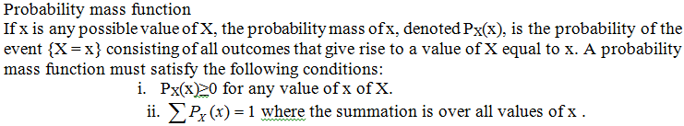

Slide 204
Example 6.1: Consider an experiment of tossing two fair coins. Letting X denote the number of heads appearing on the top face, then X is a random variable taking on one of the values 0, 1, 2 . The random variable X assigns a 0 value for the outcome (T,T), 1 for outcomes (T ,H) and (H, T ), and 2 for the outcome (H,H). Thus, we can calculate the probability that X can take specific value/s as follows:
P(X = 0) = P({(T , T )}) = ¼
P(X = 1) = P({(T ,H),(H, T )}) = 2/4,
P(X = 2) = P({(H,H)}) = ¼

Slide 205
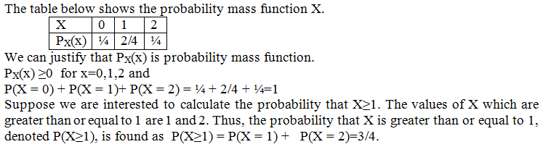

Slide 206
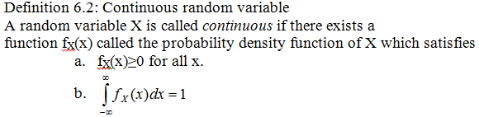

Slide 207
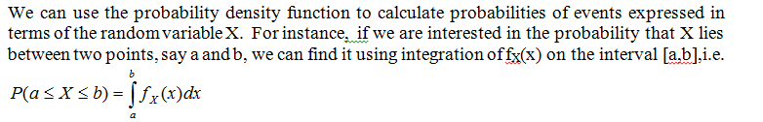

Slide 208
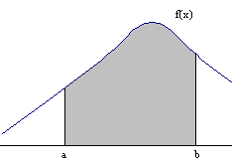
Figure: P (a≤ X ≤ b) is the shaded region

Slide 209


Slide 210
Introduction to expectation: mean and variance
We can associate with each random variable certain “averages” of interest, such as mean and variance which give useful summary of a probability distribution.

Slide 211


Slide 212

Variance

Slide 213
The variance provides a measure of dispersion of X around its mean. Another measure of dispersion is the standard deviation of X, which is defined as the square root of the variance and is denoted by σ.

Slide 214


Slide 215
Common discrete probability distributions – binomial and Poisson
The Binomial distribution
Many real problems (experiments) have two possible outcomes, for instance, a person may be HIV-Positive or HIV-Negative, a seed may germinate or not, the sex of a new born bay may be a girl or a boy, etc. Technically, the two outcomes are called Success and Failure.
Experiments or trials whose outcomes can be classified as either a “success” or as a “failure” are called Bernoulli trails.

Slide 216

Suppose that n independent trials, each of which results in a “success” with probability p and in a “failure” with probability 1 − p, are to be performed. If X represents the number of successes that occur in the n trials, then X is said to have binomial distribution with parameters n and p. The probability mass function of a binomial distribution with parameters n and p is given by

Slide 217
The mean and variance of the binomial distribution are np and np(1-p), respectively. Note that the binomial distributions are used to model situations where there are just two possible outcomes, success and failure. The following conditions also have to be satisfied.
There must be a fixed number of trials called n
The probability of success (called p) must be the same for each trial.
The trials must be independent

Slide 218
Example 6.3: A fair coin is flipped 4 times. Let X be the number of heads appearing out of the four trials. Calculate the following probabilities:
2 heads will appear
No head will appear
At least two heads will appear
Less than two heads will appear
At most heads 2 will appear

Slide 219
Solution: We can consider that the outcomes of each trial are independent to each other. In addition the probability that a head will appear in each trial is the same. Thus, X has a binomial distribution with number of trials 4 and probability of success (the occurrence of head in a trial) is ½. The probability mass function of X is given by

Slide 220


Slide 221
Example 6.5: Suppose it is known that the probability of recovery for a certain disease is 0.4. If random sample of 10 people who are stricken with the disease are selected, what is the probability that:
(a) exactly 5 of them will recover?
(b) at most 9 of them will recover?

Slide 222
Solution: Let X be the number of persons will recover from the disease. We can assume that the selection process will not affect the probability of success (0.4) for each trial by assuming a large diseased population size. Hence, X will have a binomial distribution with number of trials equal to 10 and probability of success equal 0.4.

Slide 223


Slide 224

The Poisson Random Variable
A random variable X, taking on one of the values 0, 1, 2, . . . , is said to have a Poisson distribution if its probability mass function is given by

Slide 225
λ is the parameter of this distribution. The mean and variance of the poisson distribution are equal and their values are equal to λ. Note that poisson distributions is used to model situations where the random variable X is the number of occurrences of a particular event over a given period of time (or space).

Slide 226
Together with this , the following conditions must also be fulfilled: events are independent of each other, events occur singly, and events occur at a constant rate (in other words for a given time interval the mean number of occurrences is proportional to the length of the interval).
The poisson distribution is used as a distribution of rare events such as telephone calls made to a switch board in a given minute, number of misprints per page in a book, road accidents on a particular motor way in one day, etc.
The process that give rise to such events are called poisson processes.

Slide 227
Example 6.6: Suppose that the number of typographical errors on a single page of this lecture note has a Poisson distribution with parameter λ = 1. if we randomly select a page in this lecture note, calculate the probability that
no error will occur.
exactly three errors will occur.
less than 2 errors will occur.
there is at least one error.

Slide 228


Slide 229

Example 6.7: If the number of accidents occurring on a highway each day is a Poisson random variable with parameter λ = 3, what is the probability that no accidents will occur on a randomly selected day in the future?

Slide 230

Note: The Poisson random variable has a wide range of applications in a diverse number of areas. An important property of the Poisson random variable is that it may be used to approximate a binomial random variable when the binomial parameter n is large and p is small. The probability that X will be k can be approximated by substituting λ by np in the poisson distribution, i.e.

Slide 231
Common examples of continous probability distribution
Normal distribution
Student’s T distribution
F distribution

Slide 232
Normal distribution
The normal distribution plays an important role in statistical inference because many real-life distributions are approximately normal;
many other distributions can be almost normalized by appropriate data transformations (e.g., taking the log) and as a sample size increases, the means of samples drawn from a population of any distribution will approach the normal distribution.

Slide 233
A continuous random variable X is said to follow normal distribution , if and only if , its probability density function (p.d.f.) is:

Slide 234
There are infinitely many normal distributions since different values of μ and σ define different normal distributions. For instance, when μ= 0 and σ =1 , the above density will have the following form

Slide 235
This particular distribution is called the standard normal distribution and sometimes known as Z-distribution. The random variable corresponding to this distribution is usually denoted by Z. If X has a normal distribution with mean μ and variance σ², we denote it as

Slide 236
Properties of normal distribution
The normal distribution curve is a bell shaped, symmetrical about μ and mesokurtic. The p.d.f. attains its maximum value at x= μ.
Since for x= μ divides the area under the normal curve into two equal parts, μ is the mean, the median and the mode of the distribution.
The mean and variance of the normal distribution are μ, and σ², respectively.

Slide 237

Properties of normal distribution cont….
The total area under the curve and bounded from below by the horizontal axis is 1, i.e
Figure: The shaded area under the normal curve is one

Slide 238

Since a normal distribution is a continuous probability distribution, the probability that X lies between a and b is the area bounded under the curve, from left to right by the vertical lines x = a and x = b and below by the horizontal axis.
Figure: P(a<X<b) equals the shaded region

Slide 239
However, evaluating
is very complicated.
To facilitate this problem, we use the standard normal table which gives area values bounded by two points.
Areas under the standard normal distribution curve are tabulated in various ways. The most common tables give areas bounded between Z=0 and a positive value of Z.

Slide 240
In addition to the standard normal table, the properties of normal distribution and the following theorem are useful to make probability calculations very easy for any normal distribution.

Slide 241
Standardization of a normal random variable
If X has a normal distribution with mean, μ and standard deviation ,σ , then
will have a standard normal distribution.

Slide 242
Let Z be the standard normal random variable. Calculate the following probabilities using the standard normal distribution table:
a) P(0<Z<1.2)
b) P(0<Z<1.43)
c) P(Z≤0)
d) P(-1.2<Z<0)
e) P(Z≤-1.43)
f) P(-1.43≤Z<1.2)
g) P(Z≥1.52)
h) P(Z≥-1.52)

Slide 243
Solution:
The probability that Z lies between 0 and 1.2 can be directly found from the standard normal table as follows: look for the value 1.2 from z column ( first column) and then move horizontally until you find the value of 0.00 in the first row. The point of intersection made by the horizontal and vertical movements will give the desired area (probability). Hence P(0<Z<1.2)= 0.3849. Refer the table below as a guide to find this probability.
standard normal table.docx T test and F test.docx

Slide 244


Slide 245

Figure: P(0<Z<1.2) is the shaded area

Slide 246

In a similar way P(0<Z<1.43)= 0.4236.
We know that the normal distribution is symmetric about its mean. Hence the area to the left of 0 and the to the right of zero are 0.5 each. Therefore P(Z≤0)=P(Z≥0)=0.5

Slide 247
d) P(-1.2<Z<0)=P(0<Z<1.2)= 0.3849 due to symmetry
e) P(Z<-1.43)= 1- P(Z ≥ -1.43) Using the probability of the complement event.
= 1-[P(-1.43<Z<0)+P(Z≥0)] Since a region can be broken down =1-[P(0<Z<1.43)+P(Z ≥0)] into non overlapping regions.
=1-[0.4236 + 0.5]
=1-0.9236=0.0764

Slide 248

F) P(-1.43≤Z<1.2) = P(-1.43≤Z<0) + P(0≤Z<1.2)=P(0<Z≤1.43) + 0.3849= 0.4236 + 0.3849 =0.8085
Figure: P(-1.43≤Z<1.2) is the shaded region

Slide 249

P(Z≥1.52) = 0.5 – P(0≤ Z<1.52)=0.5 – 0.4357=0.0643
Figure: P(Z≥1.52) is the shaded region

Slide 250
h) P(Z≥-1.52) = P(-1.52≤Z<0) + P(Z ≥0 )= P(0 < Z≤1.52) + 0.5 =0.4357 +0.5=0.9357

Slide 251
Example: Find the following values of z* of a standard normal random variable based on the given probability values:
P(Z > z*) =0.1446
P(Z>z*) = 0.8554
Solution: We need to find specific values of Z given some probability values.
If the probability that Z>z* is 0.1446 implies that z* is to the right of zero because
P(Z>0) = 0.5 is greater than P(Z>z*).

Slide 252

P(Z > z*) = 0.1446 implies that P(0<Z≤z*) = 0.5 -0.1446=0.3554.
Hence we can look for the value of z* satisfying the above condition form the standard normal table. Thus z* =1.06

Slide 253

If the probability that Z>z* is 0.8554 implies that z* is to the left of zero because P(Z>0) = 0.5 is less than P(Z>z*). It implies that z* is a negative number.

Slide 254
P(Z>z*) = 0.8554 = P(z*≤ Z <0) + P( Z ≥ 0) = P(0 ≤ Z ≤ - z*) + 0.5
Implies P(0 ≤ Z ≤ - z*) = 0.8554 – 0.5=0.3554. Hence the value –z* form the table satisfying the above condition is 1.06. Therefore z* = -1.06.

Slide 255
Example: If the total cholesterol values for a certain target population are approximately normally distributed with a mean of 200 (mg/100 ml) and a standard deviation of 20 (mg/100 ml), calculate the probability that a person picked at random from this population will have a cholesterol value
greater than 240 (mg/100 ml)
between 180 and 220(mg/100 ml)
less 200 (mg/100 ml)

Slide 256


Slide 257
Assume that the test scores for a large class are normally distributed with a mean of 74 and a standard deviation of 10.
Suppose that you receive a score of 88. What percent of the class received scores higher than yours?
Suppose that the teacher wants to limit the number of A grades in the class to no more than 20%. What would be the lowest score for an A?

Slide 258


Slide 259
SAMPLING AND SAMPLING DISTRIBUTION OF SAMPLE MEAN

Slide 260
Objectives:
After a successful completion of this unit, students will be able to:
Differentiate the two major sampling techniques: probabilistic and non-probabilistic
Apply simple random sampling technique to select sample
Define sampling distribution of the sample mean

Slide 261
Methods of sampling
Definition of some basic terms
Sampling: is the technique of selecting representative sample from the whole.
Population: is the totality of elements or units under study.
Sample: is the part of the population.
Sampling Frame: A complete list of all the units of the population is called the sampling frame.

Slide 262
A unit of population is a relative term. If all the workers in a factory make a population, then a worker is a unit of the population. If all the factories in a country are being studied for some purpose, then a factory is a unit of the population of factories. The frame provides a base for the selection of a sample.

Slide 263
Major reasons to use sampling
Saves Time and Cost: As the size of the sample is small as compared to the population, the time and cost involved on sample study are much less than the complete counts. Hence a sample study requires less time and cost.
To prevent destruction: The destructive nature of some experiments (or inspection) do not allow to carryout complete enumeration, for instance, to check quality of beers, to study the efficacy of new drugs, testing the life length of a bulb, e t c.
Sample survey provides higher level of accuracy: This accuracy can be achieved through more selective recruiting of interviewers and supervisors, more extensive training programs, a closer supervision of the personnel involved and a more efficient monitoring of the field work.

Slide 264
Types of sampling
Generally, two types of sampling methods exist:
probability and
non-probability sampling.

Slide 265
Probability Sampling
The term probability sampling (or random sampling) is used when the selection of the sample is purely based on chance.
There is no subjective bias in the selection of units. Every unit of the population has a known nonzero probability to be in the sample.
The following are some of the random sampling methods: Simple random sampling, Stratified random sampling, Cluster sampling, Systematic random sampling.

Slide 266
Simple random sampling
This is the most basic scheme of random sampling.
Each unit in the sampling frame has an equal chance of being selected
representativeness of the sample is ensured.
However, it is costly to conduct SRS.

Slide 267
To select a simple random sample you need to:
Make a numbered list of all the units in the population from which you want to draw a sample.
Each unit on the list should be numbered in sequence from 1 to N (where N is the size of the population)
Decide on the size of the sample
Select the required number of study units, using a “lottery” method or a table of random numbers.

Slide 268
"Lottery” method: for a small population it may be possible to use the “lottery” method: each unit in the population is represented by a slip of paper, these are put in a box and mixed, and a sample of the required size is drawn from the box.

Slide 269
Table of random numbers: if there are many units, however, the above technique soon becomes laborious.
Selection of the units is greatly facilitated and made more accurate by using a set of random numbers in which a large number of digits is set out in random order.
The property of a table of random numbers is that, whichever way it is read, vertically in columns or horizontally in rows, the order of the digits is random.

Slide 270
Suppose that a sample of 6 study centers is to be selected at random from a serially numbered population of 60 study centers.
The following table is portion of a random numbers table used to select a sample.

Slide 271

Row$>$ Column$∀$ | 1 | 2 | 3 | 4 | 5 | …… | N
1 | 2315 | 7548 | 5901 | 8372 | 5993 | ….. | 6744
2 | 0554 | 5550 | 4310 | 5374 | 3508 | ….. | 1343
3 | 1487 | 1603 | 5032 | 4043 | 6223 | ….. | 0834
4 | 3897 | 6749 | 5094 | 0517 | 5853 | ….. | 1695
5 | 9731 | 2617 | 1899 | 7553 | 0870 | ….. | 0510
6 | 1174 | 2693 | 8144 | 3393 | 0862 | ….. | 6850
7 | 4336 | 1288 | 5911 | 0164 | 5623 | ….. | 4036
8 | 9380 | 6204 | 7833 | 2680 | 4491 | ….. | 2571
9 | 4954 | 0131 | 8108 | 4298 | 4187 | ….. | 9527
10 | 3676 | 8726 | 3337 | 9482 | 1569 | ….. | 3880
11 | ….. | ….. | ….. | ….. | ….. | ….. | …..
12 | ….. | ….. | ….. | ….. | ….. | ….. | …..
13 | ….. | ….. | ….. | ….. | ….. | ….. | …..
14 | ….. | ….. | ….. | ….. | ….. | ….. | …..
15 | ….. | ….. | ….. | ….. | ….. | ….. | …..
N | 3914 | 5218 | 3587 | 4855 | 4888 | ….. | 8042

Slide 272
If you start in the first row and first column, centers numbered 23, 05, 14,…, will be selected. However, centers numbered above the population size (60) will not be included in the sample. In addition, if any number is repeated in the table, it may be substituted by the next number from the same column.

Slide 273
1, the number to start with is 83. In this way you can select first 6 numbers from this column starting with 83.
The sample, then, is as follows:
83 75
53 33
40 01
05 26
Hence, the study centers numbered 53, 40, 05, 33, 01 and 26 will be in the sample.

Slide 274
Merits and Demerits of SRS
Merits
Simple random sampling ensures the best results.
Demerits
from a practical point of view, a list of all the units of a population is not possible to obtain.
Even if it is possible, it may involve a very high cost which a researcher or an organization may not be able to afford.

Slide 275
Systematic sampling
Individuals are chosen at regular intervals ( for example, every kth) from the sampling frame.
The first unit to be selected is taken at random from among the first k units. For example, a systematic sample is to be selected from 1200 students of a school.
The sample size is decided to be 100. The sampling fraction is: 100 /1200 = 1/12. Hence, the sample interval is 12.

Slide 276
The number of the first student to be included in the sample is chosen randomly, for example by blindly picking one out of twelve pieces of paper, numbered 1 to 12. If number 6 is picked, every twelfth student will be included in the sample, starting with student number 6, until 100 students are selected. The numbers selected would be 6,18,30,42,etc.

Slide 277
Merits and demerits of systematic sampling
Merits
• Systematic sampling is usually less time consuming and easier
to perform than simple random sampling. It provides a good
approximation to SRS.
• Unlike SRS, systematic sampling can be conducted without a
sampling frame (useful in some situations where a sampling
frame is not readily available).
Demerits
• If there is any sort of cyclic pattern in the ordering of the subjects
which coincides with the sampling interval, the sample will not be
representative of the population.

Slide 278
Stratified Sampling
It is appropriate when the distribution of the characteristic to be studied is strongly affected by certain variable (heterogeneous population).
The population is first divided into groups (strata) according to a characteristic of interest (eg., sex, geographic area, prevalence of disease, etc.).
A separate sample is then taken independently from each stratum, by simple random or systematic sampling.

Slide 279
proportional allocation - if the same sampling fraction is used for each stratum.
ni = Ni*n/N
non- proportional allocation - if a different sampling fraction is used for each stratum or if the strata are unequal in size and a fixed number of units is selected from each stratum.

Slide 280
Merits and Demerits of stratified S
Merit
The representativeness of the sample is improved.
That is, adequate representation of minority subgroups of interest can be ensured by stratification and by varying the sampling fraction between strata as required.
Demerits
Sampling frame for the entire population has to be prepared separately for each stratum.

Slide 281
Cluster sampling
In this sampling scheme, selection of the required sample is done on
groups of study units (clusters) instead of each study unit individually.
The sampling unit is a cluster, and the sampling frame is a list of
these clusters.
procedure
- The reference population (homogeneous) is divided into clusters.
These clusters are often geographic units (eg districts, villages,
etc.)
- A sample of such clusters is selected
All the units in the selected clusters are studied

Slide 282
Merits and demerits of Cluster S
Merit
A list of all the individual study units in the reference population is not required. It is sufficient to have a list of clusters.
Demerit
It is based on the assumption that the characteristic to be studied is uniformly distributed throughout the reference population, which may not always be the case.
Hence, sampling error is usually higher than for a simple random sample of the same size.

Slide 283
Non-probability sampling techniques
In non-probability sampling, the sample is not based on chance.
It is rather determined by personal judgment. This method is cost effective; however, we cannot make objective statistical inferences.
Depending on the technique used, non-probability samples are classified into quota, judgment or purposive and convenience samples.

Slide 284
Convenience sampling: is a method in which for convenience
sake the study units that happen to be available at the time of data
collection are selected.
Quota sampling: is a method that ensures that a certain number of
sample units from different categories with specific characteristics
are represented. In this method the investigator interviews as many
people in each category of study unit as he can find until he has
filled his quota.
Purposive/Judgmental sampling: The study participants are purposely selected by researchers
Both the above methods do not claim to be representative of the
entire population.

Slide 285
Sampling and non-sampling errors
Sampling error is the difference between the value of a sample statistic and the value of the corresponding population parameter.
On the other hand, non-sampling error is an error that occurs in the collection, recording and tabulation of data.
Sampling error can be minimized by using appropriate sampling methods and/or increasing the sample size.
The non-sampling error is likely to increase with increase in sample size.

Slide 286

Sampling distribution of the sample mean $\overline{x}$
The value of the sample mean for any sample will depend on the elements included in that sample.
Consequently, the sample mean is a random variable.
Therefore, like other random variable, the sample means possess a probability distribution which is more commonly called the sampling distribution of sample mean.

Slide 287
In general, the probability distribution of a sample statistic is called its sampling distribution.
Sampling distribution is important in statistical inference.
The important characteristics of the sampling distribution of the sample mean are its mean, variance and the form of the distribution.

Slide 288
Example: Suppose we have a hypothetical population of size 3, consisting of three children namely: A is 3 years old, B is 6 years old and C is 9 years old. Construct sampling distribution of the sample mean of size 2 using sampling without replacement and with replacement.
Solution: The mean and variance of the population are 6 and 6, respectively.
If sampling is without replacement we will have ₃C₂ = 3 possible samples: (A, B), (A, C) and (B, C) and their corresponding sample means are (3+6)/2 = 4.5, 6 and 7.5, respectively. Hence the probability distribution (sampling distribution) of the sample mean is:

Slide 289


Slide 290

Note:
The mean of the sampling distribution of the sample mean is the same as the population mean irrespective of the sampling procedure.
The variance of the sampling distribution of the sample mean is:

Slide 291
The problem with using sample mean to make inferences about the population mean is that the sample mean will probably differ from the population mean.
This error is measured by the variance of the sampling distribution of the sample mean and is known as the standard error.
The standard error is the average amount of sampling error found because of taking a sample rather than the whole population.
As sample size increases, the standard error decreases.

Slide 292


Slide 293


Slide 294
REGRESSION METHODS AND CORRELATION

Slide 295
Introduction
The statistical methods discussed so far are used to analyze the data involving only one variable.
Often an analysis of data concerning two or more variables is needed to look for any statistical relationship or association between them.
Thus, regression and correlation analysis are helpful in ascertaining the probable form of the relationship between variables and the strength of the relationship.

Slide 296
Simple linear regression analysis
Regression analysis is the statistical method that helps to formulate a functional relationship between two or more variables.
It can be used for assessment of association, estimation and prediction.
For instance one might be interested to formulate a statistical model to relate the height of fathers and their sons, blood pressure and age, fertilizer amount and yield, etc.

Slide 297
A simple model to relate dependent (response) variable Y and with only one predictor variable X is to consider a linear relationship.
The first step in regression analysis involving two variables is to construct a scatter plot (diagram) of the observed data.
Scatter diagram is a plot of all ordered pairs (Xi,Yi) on the coordinate plane which is helpful for determining an apparent relationship between two variables.

Slide 298
The simple linear regression of Y on X can be expressed with respect to the population parameters α and β as
where = y-intercept that represents the mean value of the dependent variable Y when the independent variable X is zero; = slope of the regression line that represents the change in the mean of for a unit change in the value of ; = error term

Slide 299

The population parameters α and β can be estimated from sample data using the least square technique. The estimators of α and β are usually denoted by a and b, respectively.
The resulting regression line is:
and the equation is known as the fitted regression line.
The estimated values of y are denoted by . The observed values of are denoted by y

Slide 300


Slide 301


Slide 302


Slide 303


Slide 304


Slide 305


Slide 306
The covariance and the correlation coefficient
Correlation coefficient measures the degree of linear relationship between two variables. The population correlation coefficient is represented by ρ and its estimator is r.
For a set of n pairs of sample values X and Y, Pearson’s correlation coefficient is calculated as the ratio of the covariance of the variables X and Y to the product of the standard deviations of X and Y.

Slide 307


Slide 308

Properties of Pearson’s correlation coefficient r,

Slide 309


Slide 310


Slide 311


Slide 312
ESTIMATION AND HYPOTHESIS TESTING

Slide 313
Objectives:
Having studied this unit, you should be able to
construct and interpret confidence interval estimates
formulate hypothesis about a population mean
determine an appropriate sample size for estimation

Slide 314
Introduction
We now assume that we have collected, organized and summarized a random sample of data and are trying to use that sample to estimate a population parameter.
Statistical inference is a procedure whereby inferences about a population are made on the basis of the results obtained from a sample.

Slide 315
Introduction
Statistical inference can be divided in to two main areas: estimation and hypothesis testing.
Estimation is concerned with estimating the values of specific population parameters;
hypothesis testing is concerned with testing whether the value of a population parameter is equal to some specific value.

Slide 316

Point and interval estimation of the mean

Slide 317


Slide 318


Slide 319

From the standard normal distribution, we know that

Slide 320


Slide 321


Slide 322


Slide 323


Slide 324


Slide 325
Hypothesis Testing about the Mean
In many circumstances we merely wish to know whether a certain proposition is true or false.
Different people can form different opinions by looking at data, but a hypothesis test provides a standardized decision-making process that will be consistent for all people.

Slide 326
Statistical hypothesis: is a claim (belief or assumption) about an unknown population parameter values.
Examples of hypothesis:
There is association between lung cancer and number of cigarettes an individual smokes.
The proportion of female students in AASTU is 0.35.
In sub-Saharan Africa 40% of individuals are leaving below poverty line.
Hypothesis testing: is the procedure that enables decision-makers to draw inferences about population characteristics by analyzing the difference between the value of sample statistic and the corresponding hypothesized parameter value.

Slide 327
General procedure for hypothesis testing
To test the validity of the claim or assumption about the population parameter, sample is drawn from the population and analyzed.
The result of the analysis are used to decide whether the claim is valid or not.

Slide 329
Step 2: State the level of significance (alpha) for the test
The level of significance is the probability to wrongly reject the null hypothesis when it is actually true. It is specified by the statistician or the researcher before the sample is drawn. The most commonly used values are 0.10, 0.05 or 0.01.

Slide 330


Slide 331


Slide 332
Step 4: Establish a decision rule (critical or rejection region)
The cut-off point to reject or not reject depends on the level of significance , the type of test statistic chosen and the form of the alternative hypothesis. If the value of the test statistic falls in the rejection region, the null hypothesis is rejected, otherwise we do not reject (see the next fig).
The value of the sample statistic that separates the regions of acceptance and rejection is called critical value. For a specified , we read the critical values from the Z or t tables, depending on the test statistic chosen.

Slide 333


Slide 334

Based on the form of the alternative hypothesis and the test statistic we can make the following decisions:

Slide 335


Slide 336


Slide 337


Slide 338
Step 5: Interpret the result.
Errors in Hypothesis Testing
Ideally the hypothesis testing procedure should lead to the rejection of the null hypothesis when it is false and non rejection of when it is true.
However, the correct decision is not always possible. Since the decision to reject or do not reject a hypothesis is based on sample data, there is a possibility of committing an incorrect decision or error.

Slide 339

Hence, a decision-maker may commit one of the two types of errors while testing a null hypothesis. These errors are summarized as follows:

Slide 340
Type I error is committed if we reject the null hypothesis when it is true. The probability of committing a type I error, denoted by is called the level of significance.
The probability level of this error is decided by the decision-maker before the hypothesis test is performed. Type II error is committed if we do not reject the null hypothesis when it is false.
The probability of committing a type II error is denoted by (Greek letter beta). As type one error increases type two errors will decrease (they are inversely proportional).
Hence we cannot reduce both errors simultaneously.
As the sample size increases both errors will decrease.

Slide 341
Example 8.3: The life expectancy of people in the year 1999 in a country is expected to be 50 years. A survey was conducted in eleven regions of the country and the data obtained, in years, are given below:
Life expectancy (years): 54.2, 50.4, 44.2, 49.7, 55.4, 47.0, 58.2, 56.6, 61.9, 57.5, and 53.4.
Do the data confirm the expected view? (Assuming normal population) Use 5% level of significance.

Slide 342


Slide 343


Slide 344
Example 8.4: Suppose that we want to test the hypothesis with a significance level of .05 that the climate has changed since industrialization. Suppose that the mean temperature throughout history is 50 degrees.
During the last 40 years, the mean temperature has been 51 degrees and the population standard deviation is 2 degrees. What can we conclude?

Slide 345


Slide 346


Slide 347
Example 8.5: A study was conducted to describe the menopausal status, menopausal symptoms, energy expenditure and aerobic fitness of healthy midwife women and to determine relationship among these factors. Among the variables measured was maximum oxygen uptake (Vo_{2max).} The mean Vo_{2max} score for a sample of 242 women was 33.3 with a standard deviation of 12.14. On the basis of these data, can we conclude that the mean score for a population of such women is greater than 30? Use 5% level of significance.

Slide 348


Slide 349


Slide 350
Thank you!!!

